Slide 1
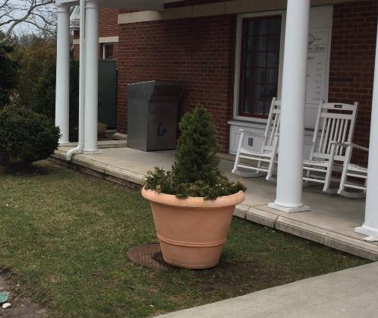
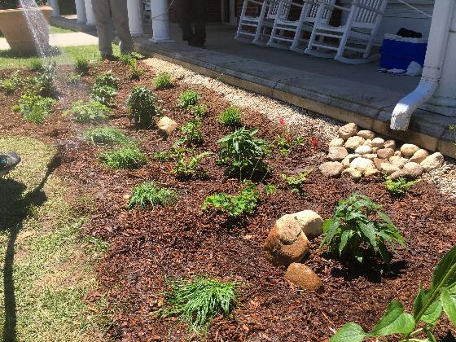
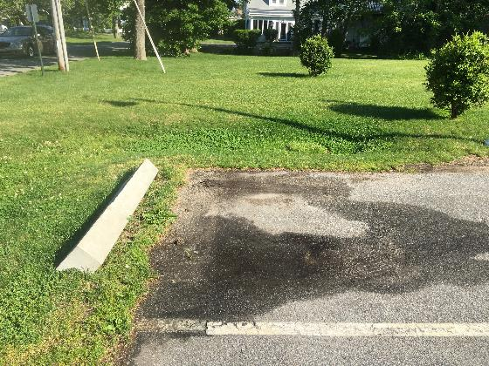
WORKSHOP I: Green Infrastructure Overview and Maintenance
Stormwater BMP Maintenance – Osterville Library
11.8.17

Slide 2
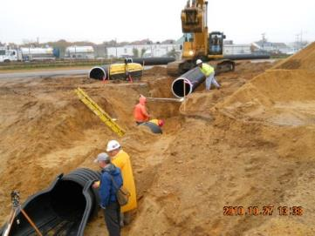
WHY IS THIS IMPORTANT?
OPERATION AND MAINTENANCE
REGULATIONS AND DESIGN MANUALS
STATE AND LOCAL AGENCIES
OWNERS & OPERATORS
DESIGNERS
CONSTRUCTION DRAWINGS
INSTALLATION
CONTRACTORS

Slide 3
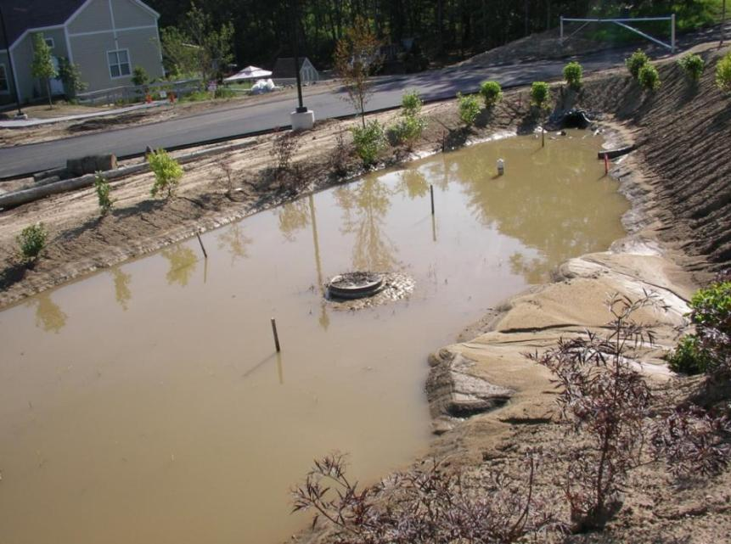

Slide 4
HOW CAN WE AVOID THIS?
1 Drainage Inlets
2 Swales & Conveyance
3 Sediment Capture
4 Treatment Areas
(Bioswales/Raingardens)
5 Overflow & Spillways
6 Surrounding Area
Vegetation
Long-Term Maintenance
Notes:
Why proper installation/materials are important
Importance of maintenance

Slide 5
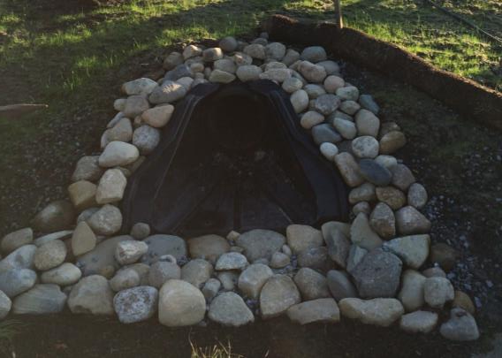
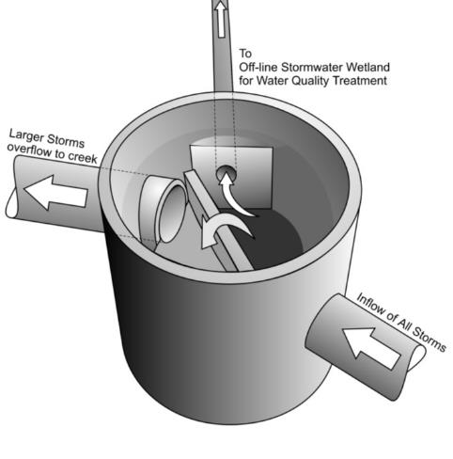
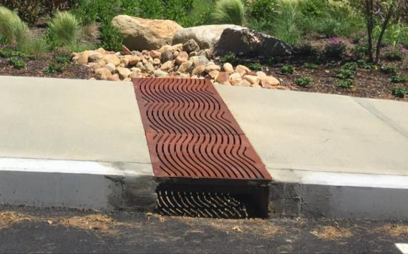
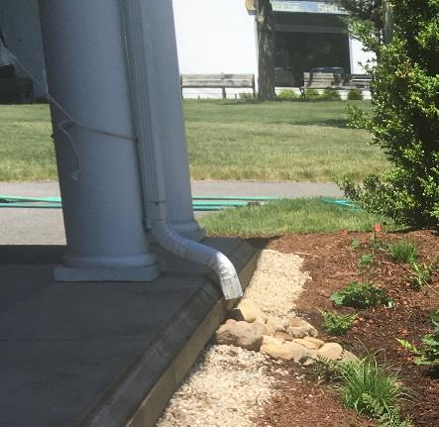
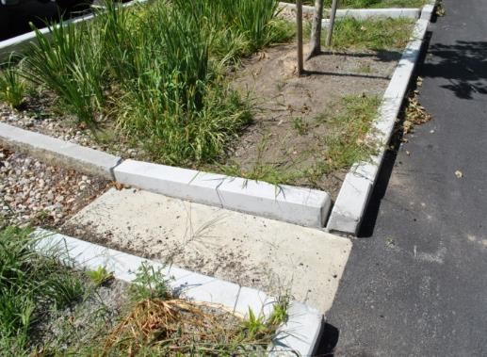
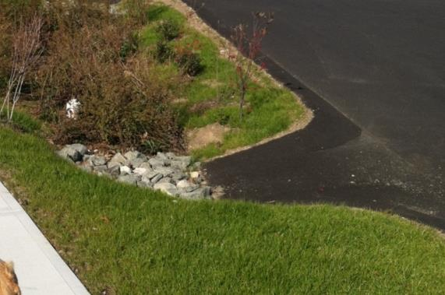
1 DRAINAGE INLETS
Diversion struct.
Pipe Inlets
Trench grates
Curb Cuts
Paved inlet flumes
Catch basins
Roof downspouts
Notes:
Why proper installation/materials are important
Importance of maintenance

Slide 6
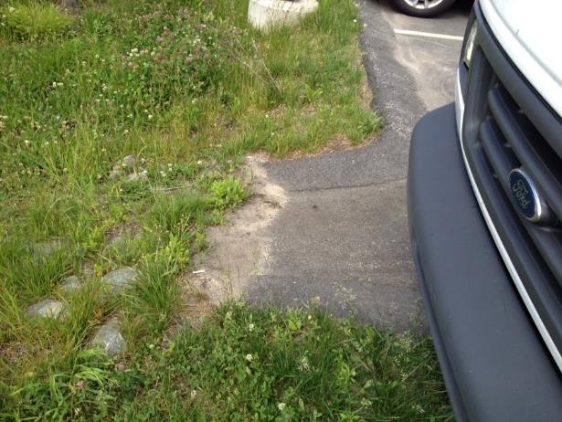
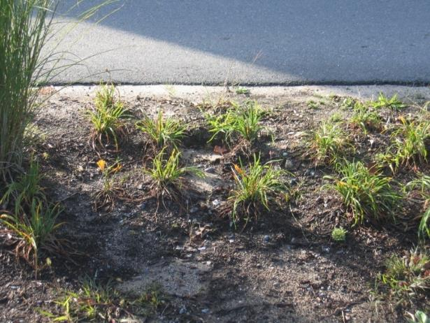
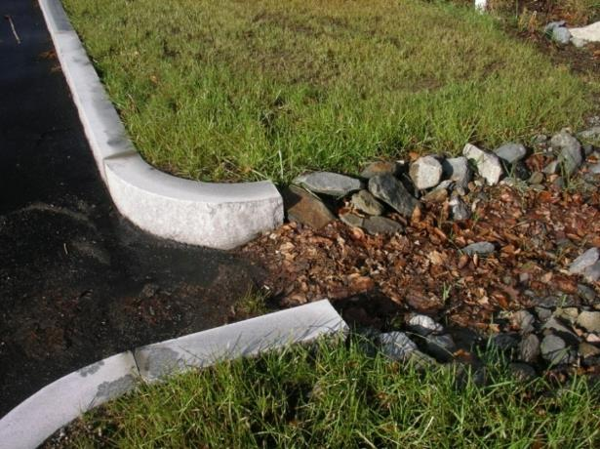
MAINTENANCE
Clean sediment
Remove leaf litter from inlets
Watch for scouring
Inlet Clogging

Slide 7
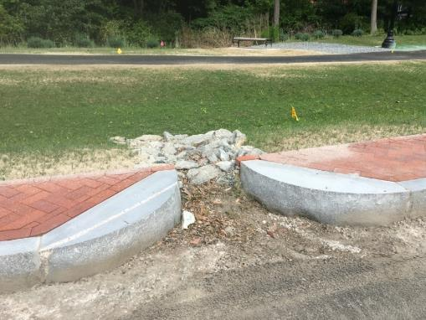
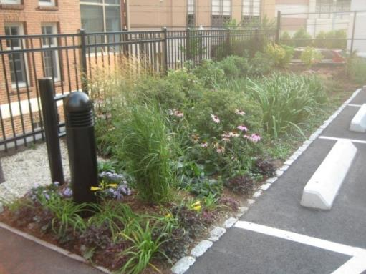
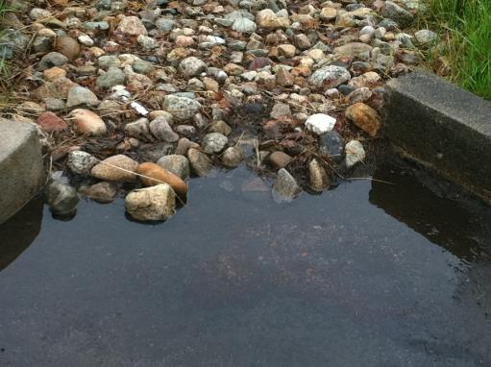
LESSONS LEARNED
Stones prone to clogging
Ensure it is located at the low point and water can enter easily.
Curbing increases side slope and depth
When applicable zero curb
Allow for sheet flow

Slide 8
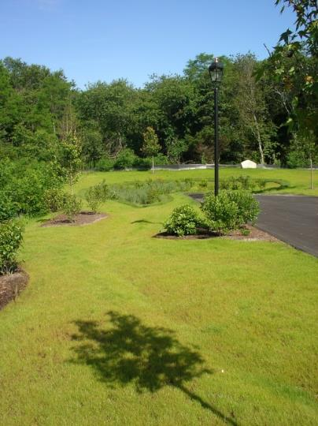
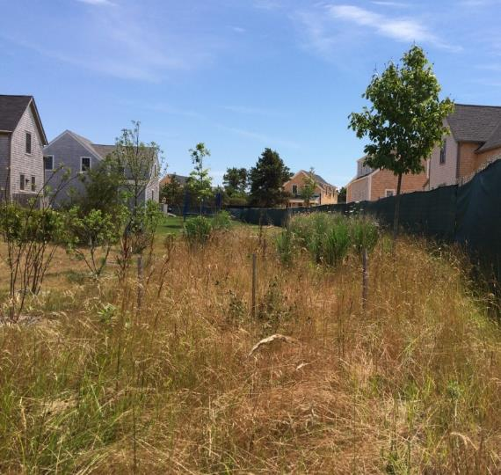
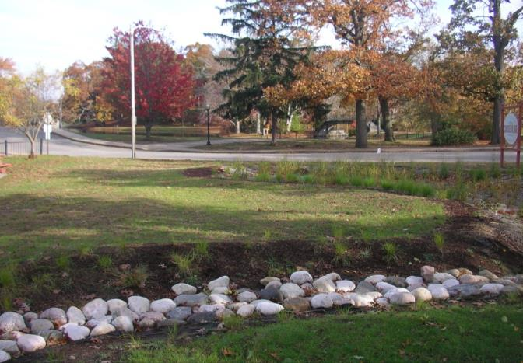
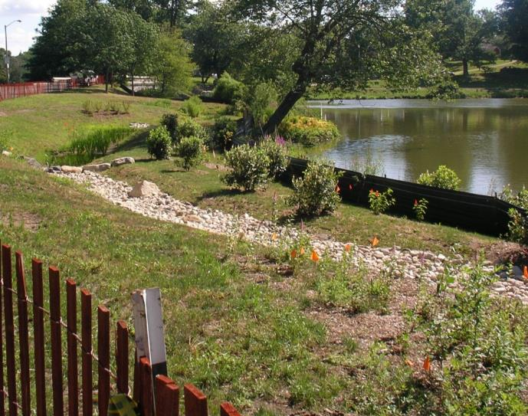
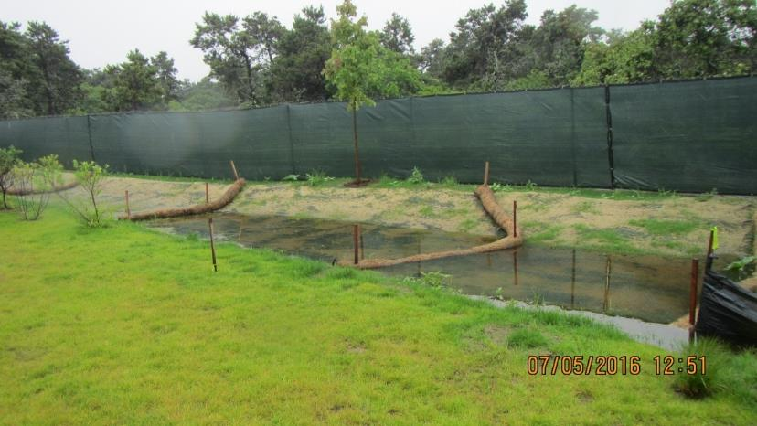
2 SWALES & CONVEYANCE
Grass swales
Vegetated swales
Turf reinforced (TRM) swales
Stone swales
Notes:
Why proper installation/materials are important
Importance of maintenance

Slide 9
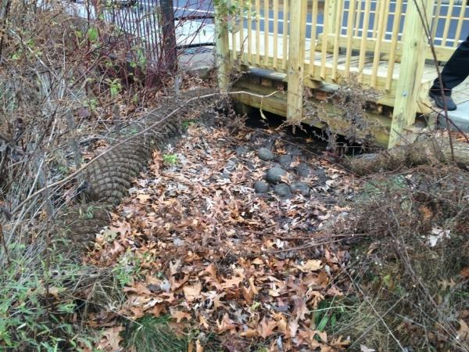
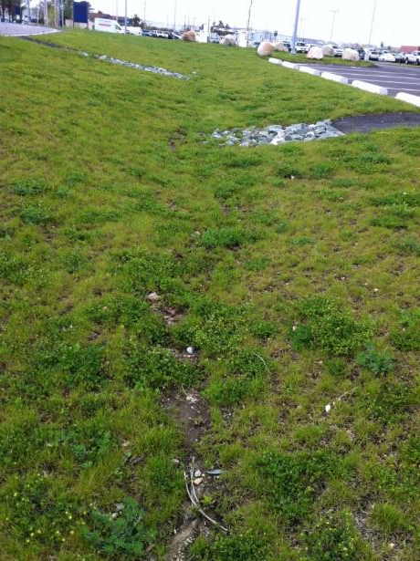
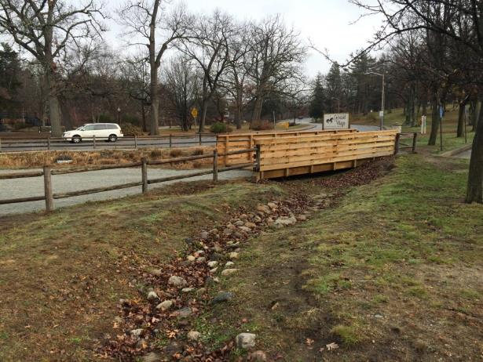
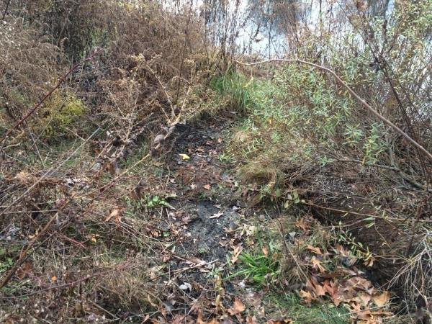
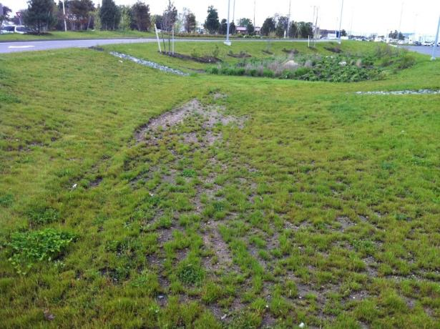
MAINTENACE
Debris Cleanout
Sediment/Organic Debris Removal
Check for areas of erosion/ gullies in the swale, particularly along the swale bottom.
Repair/reseed as necessary
Overtopped berm

Slide 10
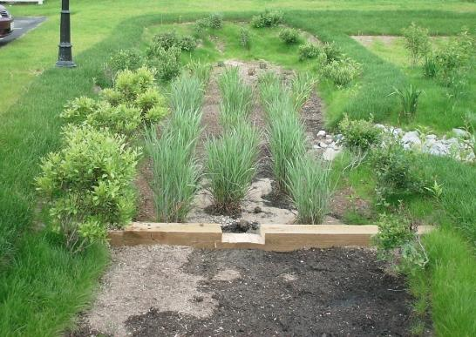
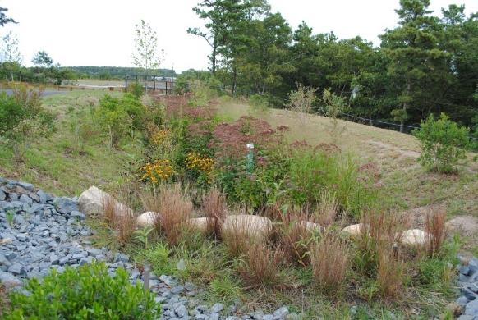
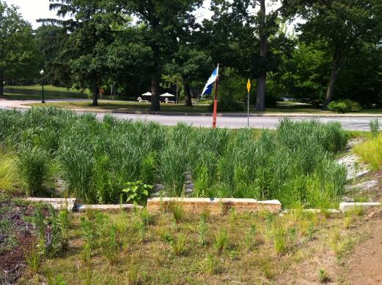
3 SEDIMENT COLLECTION
Notes:
Why proper installation/materials are important
Importance of maintenance

Slide 11
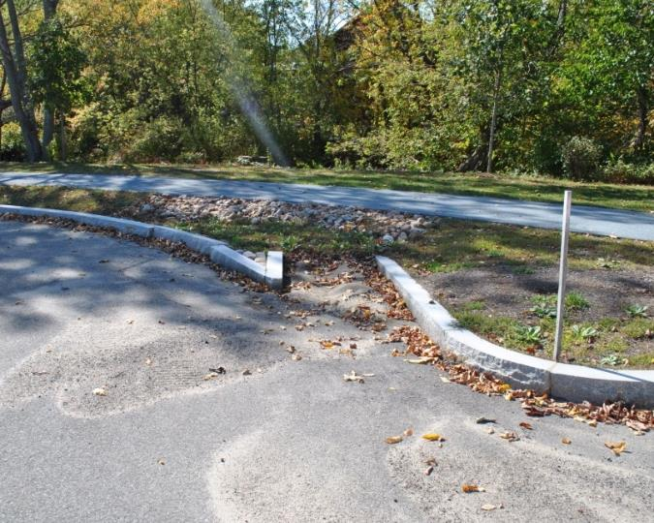
MAINTENANCE
Remove trash and debris from the surface.
Signs of erosion gullies. Repair as necessary.
Remove sediment accumulation and properly dispose when accumulation is greater than or equal to 3 inches or you cannot see stones.*

Slide 12
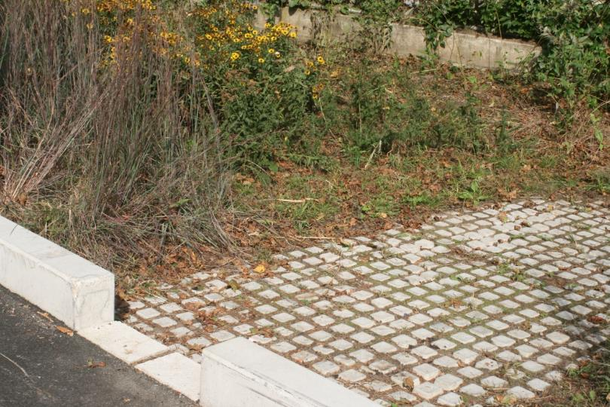
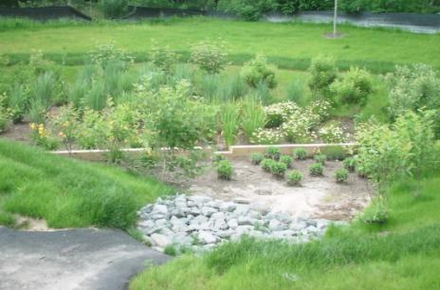
LESSONS LEARNED
Early Designs
Inlets & Sediment collection areas or “forebays” with rip/rap or stone
Sediment forebays large/difficult to clean
Lessons Learned
Smaller forebay/more frequent cleaning
Use a hardscape smooth surface at the bottom
Notes:
Aha moment - Spend time during construction trying to keep sediment out at the inlet. Why nor design this way with more frequent cleaning
Stone at inlet set too high- traps sediment at the paved flume. Incorrect installation, but why not design to trap sediment before entering the treatment area.

Slide 13
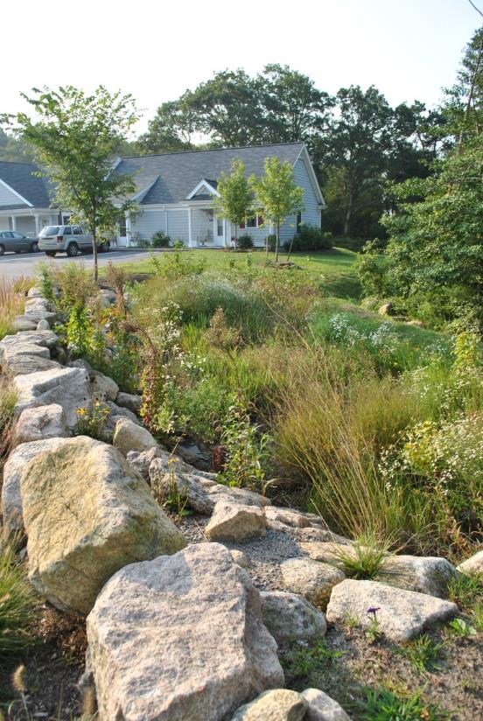
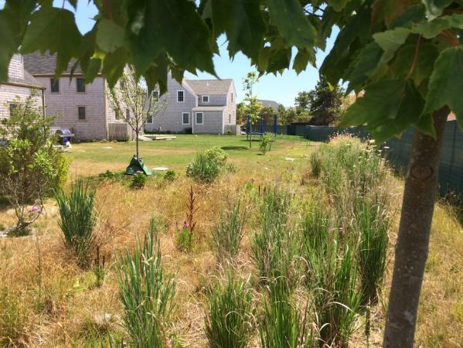
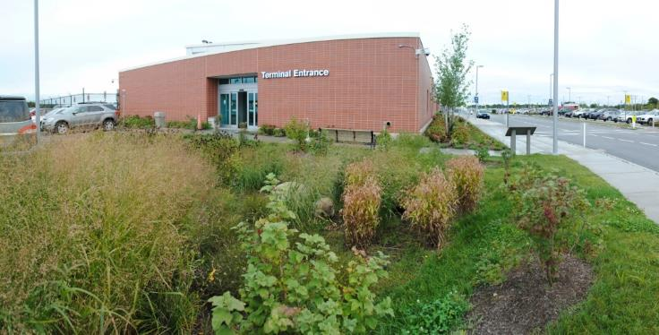
4 TREATMENT AREAS
Notes:
Why proper installation/materials are important
Importance of maintenance

Slide 14
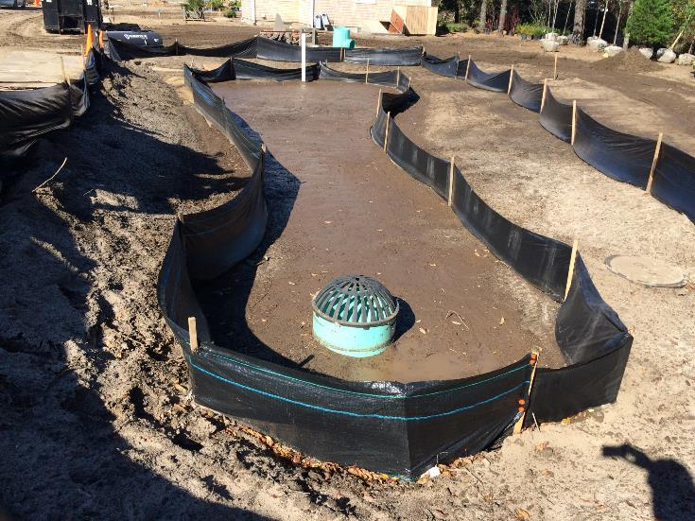
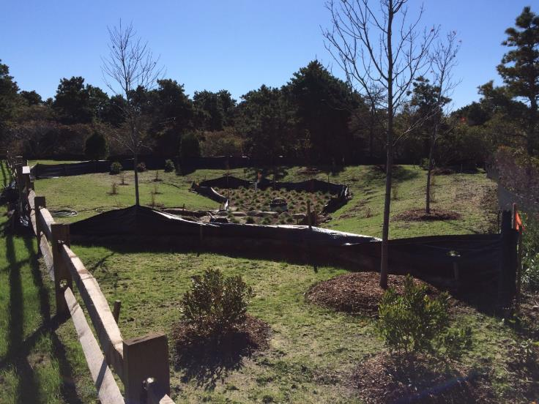
MAINTENANCE
Debris Cleanout
Signs of erosion gullies, animal burrowing, overtopping or slumping
Sediment/Organic Debris Removal
Vegetation Maintenance & Replacement
Water Draining properly
If standing water is observed for more than 48 hours after a storm event maintenance required

Slide 15
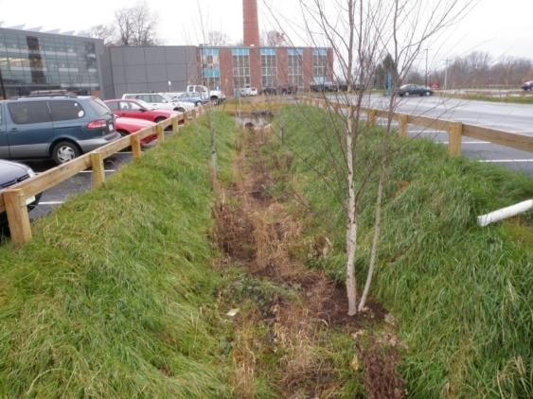
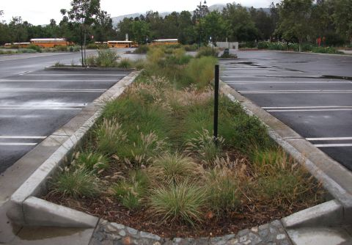
LESSONS LEARNED
Early Designs
6”-12” depth
Flat bottom – zero slope
Became too deep
Side slope stabilization
Curb and gutter systems
Lessons Learned
Shallower depth has advantages
Use check dams
More cells
Benefit
Aesthetics
Improved Function
Easier Maintenance
Source: Los Angeles Zoo designed by others

Slide 16
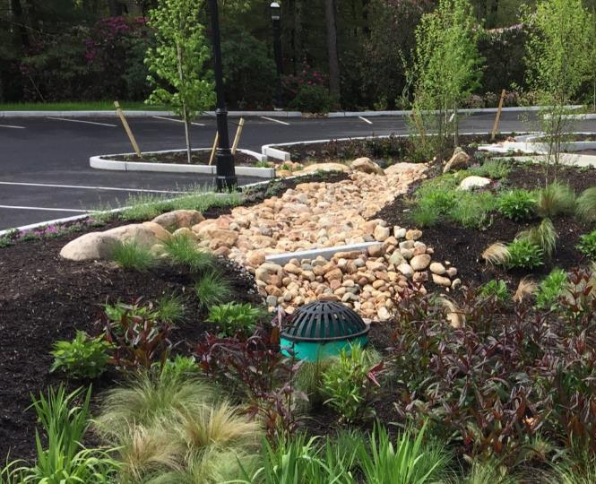
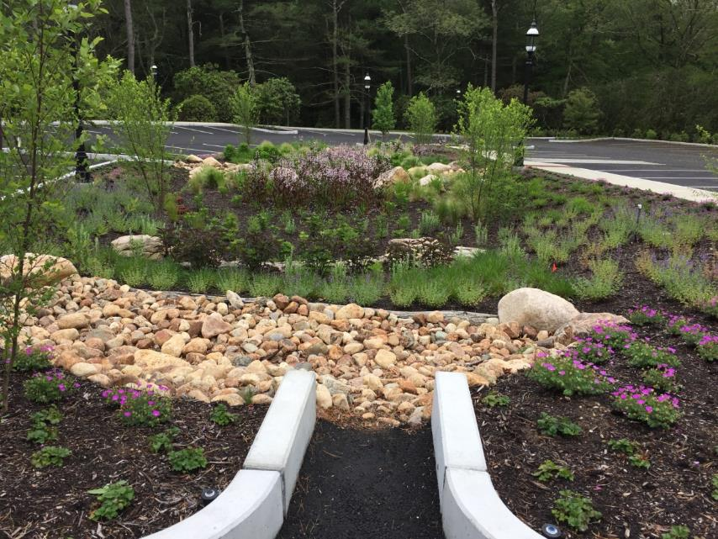
5 OVERFLOW & SPILLWAYS
Overflow/Outlet Structures
Spillways
Notes:
Why proper installation/materials are important
Importance of maintenance

Slide 17
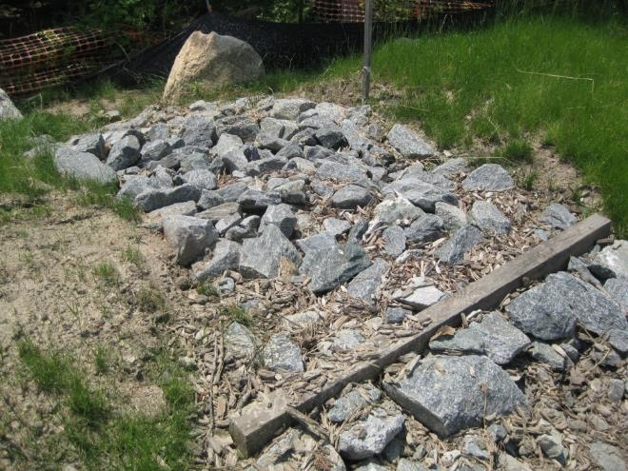
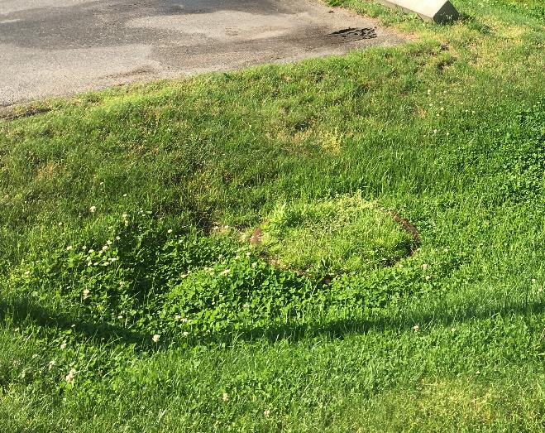
MAINTENANCE
EMERGENCY SPILLWAYS
Check for settling gulling, erosion damage, settling & clogging
Repair as necessary and return to design grades
OVERFLOW STRUCTURE
Check for sediment accumulation that impacts inflow. If sediment accumulation. Schedule cleaning
Check for leaf litter, debris and inlet clogging

Slide 18
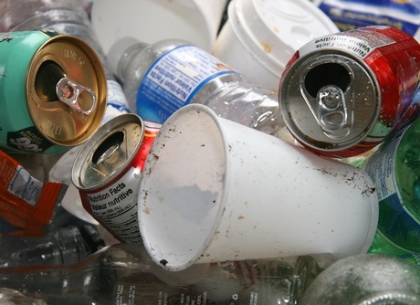
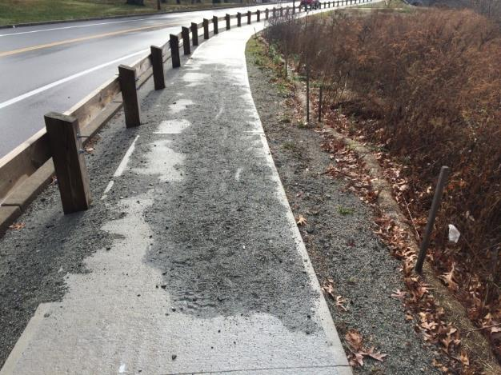
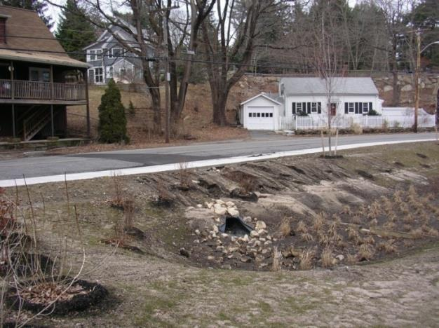
6 SURROUNDING AREA
Debris Removal
Remove trash from perimeter areas.
Pavement Sweeping
Sweep parking lot minimum once a year after spring thaw.
Drainage Network
Ensure proper operation.
Contributing drainage area stabilized
Notes:
Why proper installation/materials are important
Importance of maintenance

Slide 19
VEGETATION
Pruning
Why?
Maintain plant health and vigor
Removal of dead or broken wood
Encouragement of flowering and fruiting
Control of overgrowth of plant material
When?
Annually – Fall or Spring
Weeding
Why?
Control invasive plants
Promote native non-invasive plant growth
When?
Monthly
April thru October
Do not use chemical herbicides
Remove by hand
Notes:
10:00 – 10:30 GI Maintenance Activities (4 slides)
Vegetation management and maintenance – importance of plant lists and understanding native plants vs. invasives

Slide 20
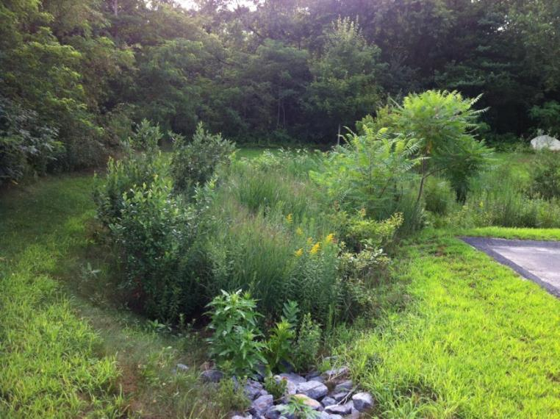
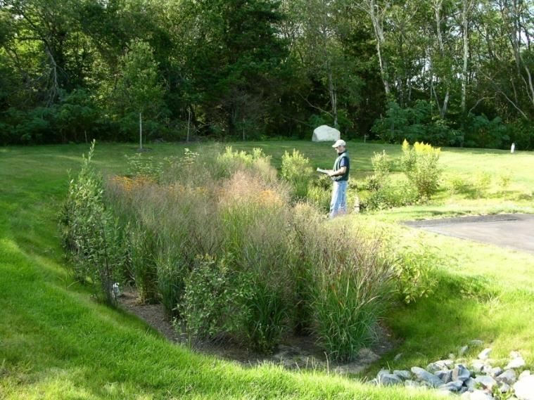
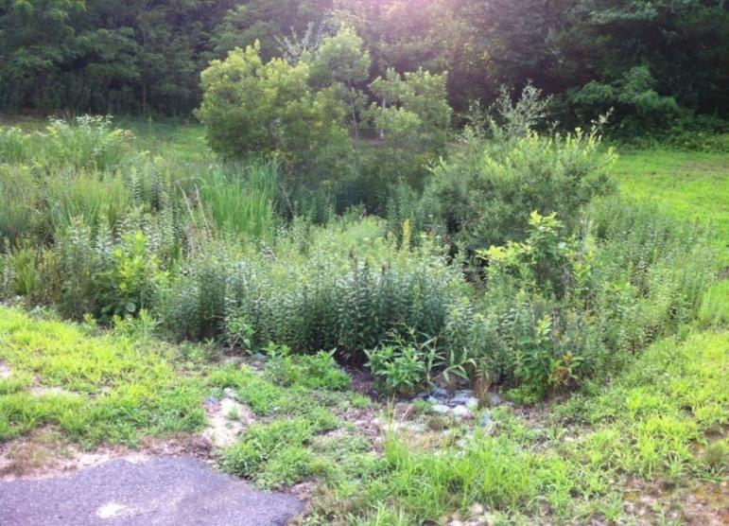
VEGETATION
Notes:
10:00 – 10:30 GI Maintenance Activities (4 slides)
Vegetation management and maintenance – importance of plant lists and understanding native plants vs. invasives

Slide 21
LESSONS LEARNED
Early Designs
Ornamental/flowering “gardens”
Predominantly Native Plants
Included Larger shrubs
Trees often excluded
Lessons Learned
Greater mix of plants
Grasses, Herbs and Forbs do
well
Less manicured and ornamental more wild & natural
Work with Nature
Source: SW Montgomery Green Street Plan by Nevue Ngan
Notes:
Is weedy/unkept and option?
Do a better job managing expectations
Changing people’s perspective/habitats

Slide 23
SMART WEED

Slide 24
ORIENTAL BITTERSWEET
JAPANESE KNOTWEED

Slide 25
TO MOW OF NOT MOW?
THAT IS THE QUESTION ?

Slide 26
FERTILIZING
Fertilization should not be necessary
Compromises pollutant reduction effectiveness
Leads to weak plant growth
Promotes disease and pests
Inhibits soil life

Slide 27
SHORT-TERM MAINTENANCE
Why Inspect?
Ensure proper design function after construction
When to inspect?
6 months period after construction
Monthly during an immediately after construction
After rain events of 1” and greater
What to inspect?
Erosion and Gullying
Grass/Plant growth
Washouts Inlet flumes or pipes inlets
Sediment forebay
Notes:
10:00 – 10:30 GI Maintenance Activities (10-12 slides)
Typical routine and long-term maintenance measures

Slide 28
LONG-TERM MAINTENANCE
When to inspect?
Spring thru fall
During the typical routine landscape maintenance:
Once per month
After large storm events
During other extreme weather events
What to Inspect?
Debris Accumulation
Sediment build up
Weeds and invasive plants
Plant and grass health
Erosion/Gullying
Inlet/Outlet structure clogging

Slide 29
How Do They Work?

Slide 30
Pavement Reduction
SITE 12
Stormwater
Pretreatment
Buffer Restoration

Slide 31
SITE 3b

Slide 35
THANK YOU!
QUESTIONS?

Slide 36
HANDS-ON MAINTENANCE EXERCISE
10:45 – 11:45 Hands-on Maintenance Exercise
Visit the rain garden at the library
Visit the swale in the back of the parking lot

