Slide 1
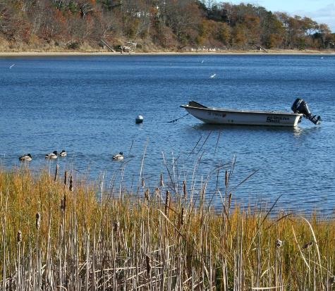
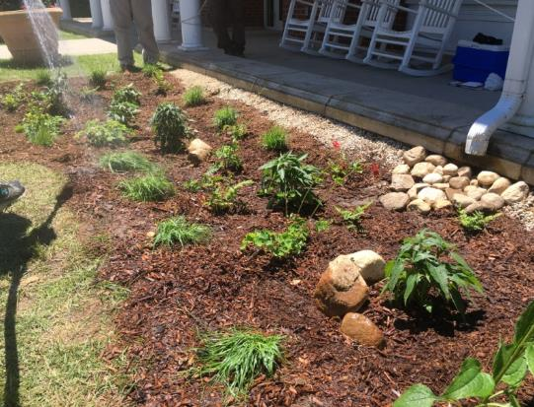
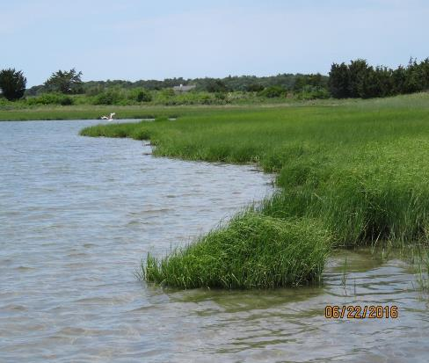
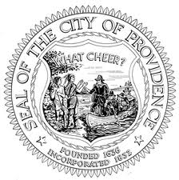



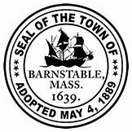


WORKSHOP I:
Green Infrastructure Overview
Construction, Inspection, and Maintenance
Stormwater BMP Maintenance DPW Staff and Municipal Stormwater Managers
10.31.17

Slide 2
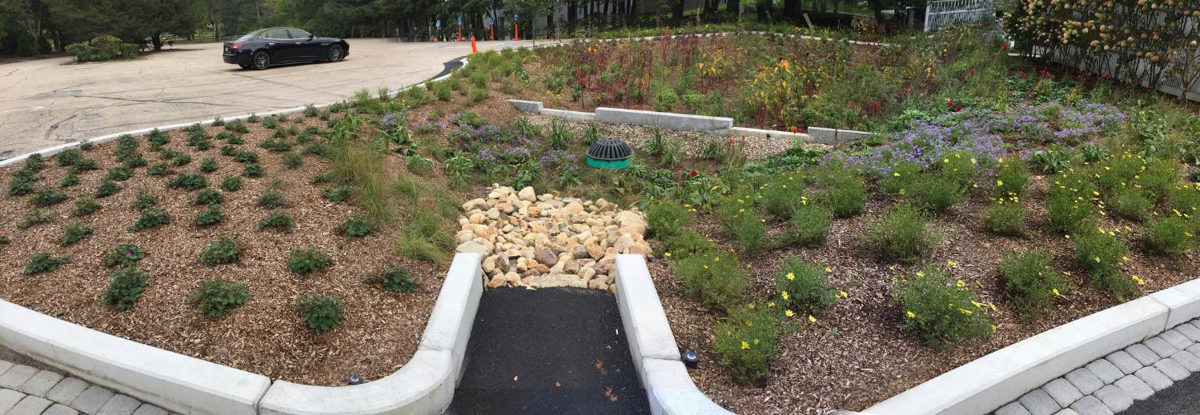
PRESENTATION OUTLINE
8:15 - 8:45 Green Infrastructure Practice Overview
Why Green Infrastructure (GI)
Overview of GI BMPs and how they work
Using the right GI in the right places (will cover this as we go)
Bioretention at Heritage Museum and Gardens, Sandwich, MA

Slide 3
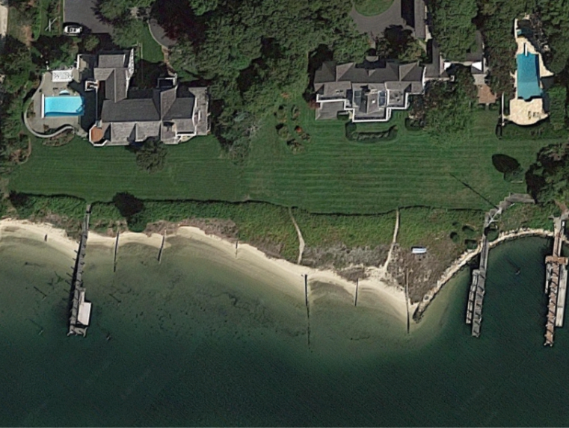
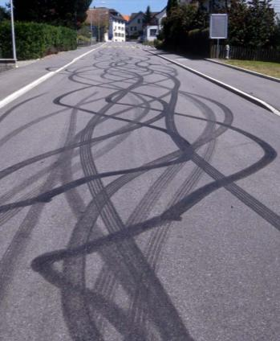
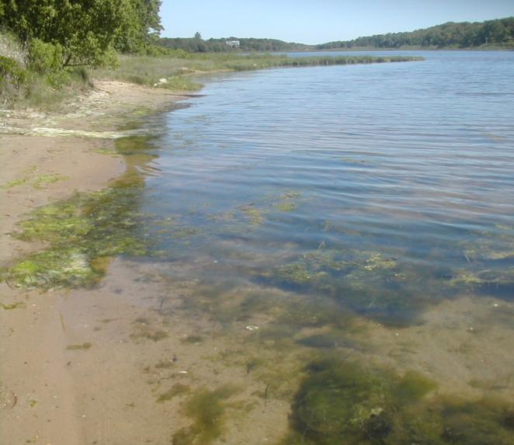
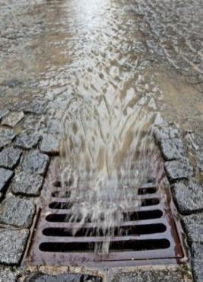
Many Cape Estuaries Impaired by Excess Nitrogen and Bacteria
Notes:
Listed as impaired by state to meet requirements set forth by the Federal Clean Water Act section 303d.
Widespread degradation of the bays and direct human health and environmental threats.
Hence a strong focus of this project to focus on remediation of N and bacteria sources to bays.

Slide 4
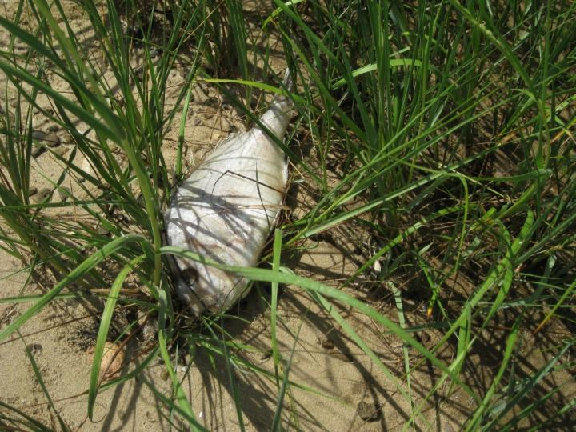
Negative Effects on the Environment and Community
Algal blooms from excessive nutrient delivery; loss of aquatic grasses (eelgrass); low dissolved oxygen; and fish kills
Impacts human uses (swimming, boating, fishing); aesthetics; and property values
Notes:
Unmanaged stormwater can (and is) leading to…
Effects on Environment
Excessive Algal Growth: Estuaries are typically nitrogen limited systems. Excess nitrogen → rapid plant or algae growth (blooms)
Habitat degradation: including 100% loss of eelgrass throughout the Three Bays estuary. Eelgrass as a keystone species to provide habitat for other species (scallops).
Algal decomposition uses up oxygen leading to low O₂ levels which can harm wildlife and cause fish kills.
Effects on Community:
Health hazards
Beach closures
Shellfishing closures
Algal nuisance
Aesthetics and odor
Lower property values

Slide 5
What is Green Infrastructure?
An approach to land development/ redevelopment that mimics nature in managing stormwater runoff
A term that is used differently by different disciplines and in different contexts
  GI / GSI / LID
Stormwater practices that infiltrate, evaporate, or harvest and re-use stormwater runoff as close to its source as possible
Uses soils, shallow depressions, and vegetation to minimize runoff and closely reflect natural conditions
MULTIPLE BENEFITS

Slide 6
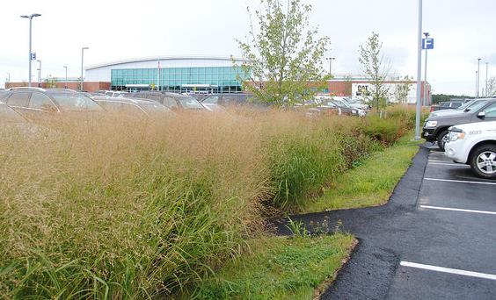
Green Infrastructure Principles
Treats stormwater
as a resource rather than a waste product
Preserves and/or recreates natural landscape features
Minimizes the effects of impervious cover
Implements stormwater practices that rely on natural systems to manage runoff
Bioretention at HYA, Hyannis, MA

Slide 7
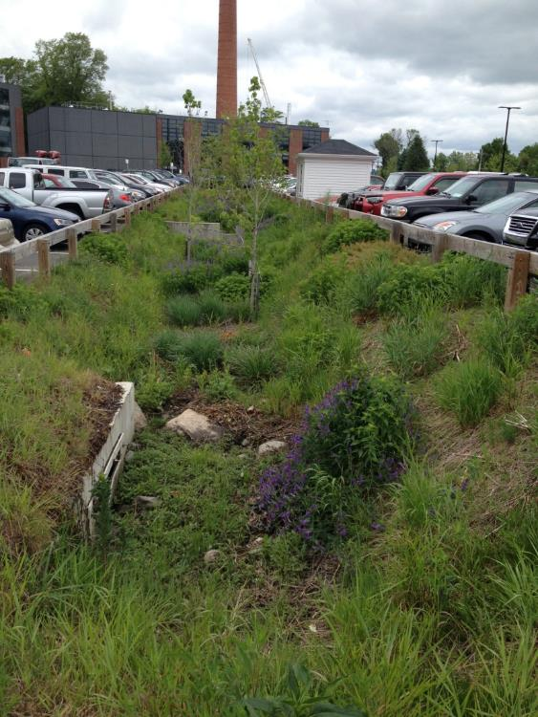
Green Infrastructure Benefits
WATER
  Runoff volume reduction and less flooding
  Natural recharge to groundwater
  Pollutant reduction and cleaner water
ENERGY
  Reduced urban heat island effect
  Less energy used for cooling
AIR QUALITY
  Natural uptake of pollutants from air
Bioretention at BSU, Bridgewater, MA

Slide 8
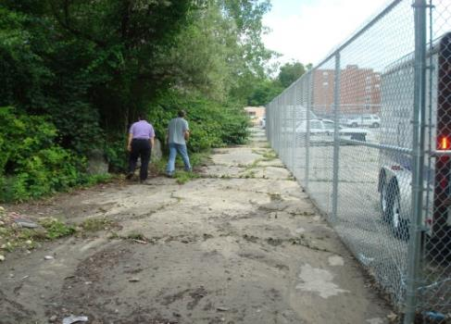
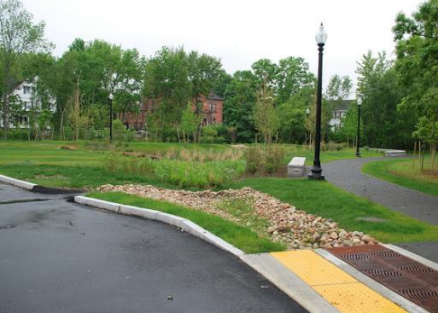
Green Infrastructure Benefits
COMMUNITY AND HABITAT
  Increased wildlife habitat
  More recreational space
  Increased property values
  Increased public awareness
COSTS
  Reduced landscaping costs
  Less wastewater treatment costs
  Less life-cycle costs
REGULATORY COMPLIANCE
  Compliant with permit requirements
Before
After
Mill River Park Taunton, MA

Slide 9
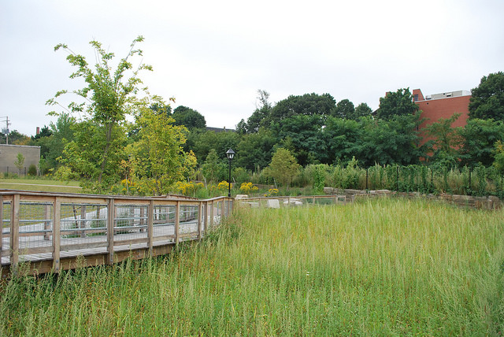
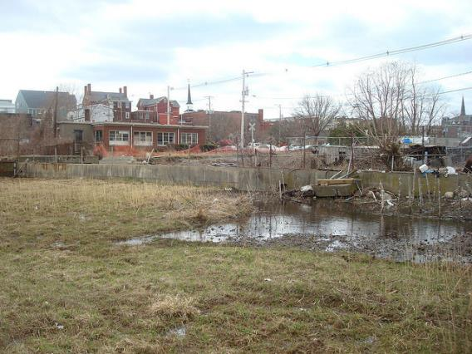
Resilience
Flood mitigation
Drought mitigation
Adaptability
Before: Contamination, flood, blight
After: Multipurpose space, flood storage
East End Veteran’s Memorial Park, Peabody, MA

Slide 10
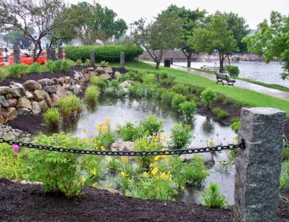
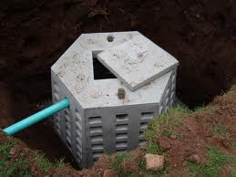
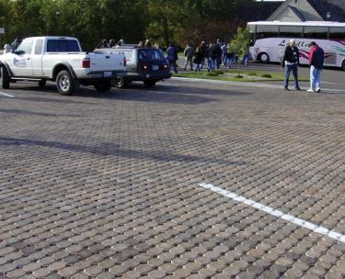
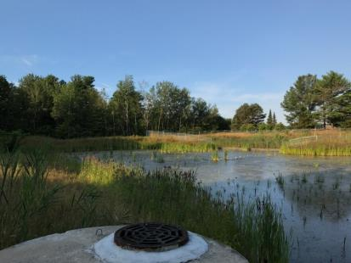
GREEN INFRASTRUCTURE PRACTICES
Bioretention and Green Street Practices
Permeable/Porous/Pervious Pavements
Infiltration Practices
Swales and Channels
Constructed Wetlands
Rainwater Harvesting
Green and Blue Roofs
Non-Structural Practices

Slide 11
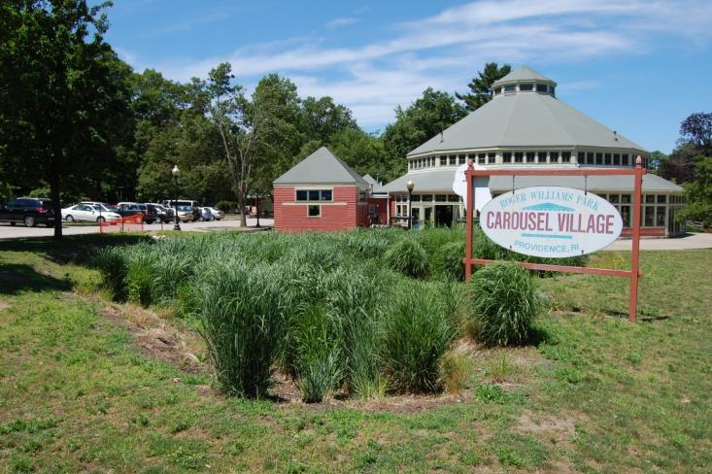
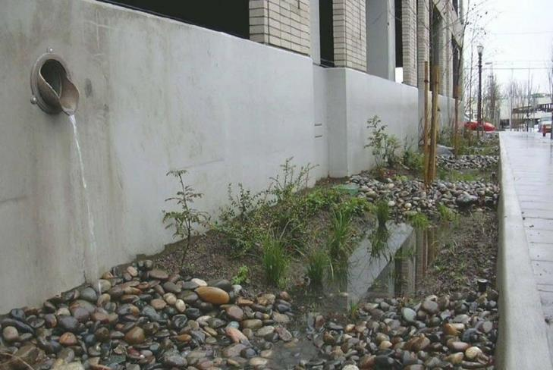
Bioretention and Green Streets
  Shallow landscaped depression designed to capture stormwater runoff for treatment and/or infiltration through natural processes.
Practice Variants:
  Bioretention
  Tree Filters
  Stormwater Planters
  Rain Gardens

Slide 12
Bioretention Schematic
Runoff
Vegetation on Surface
Planting Soil -
Primarily Sand
Underdrain System

Slide 13
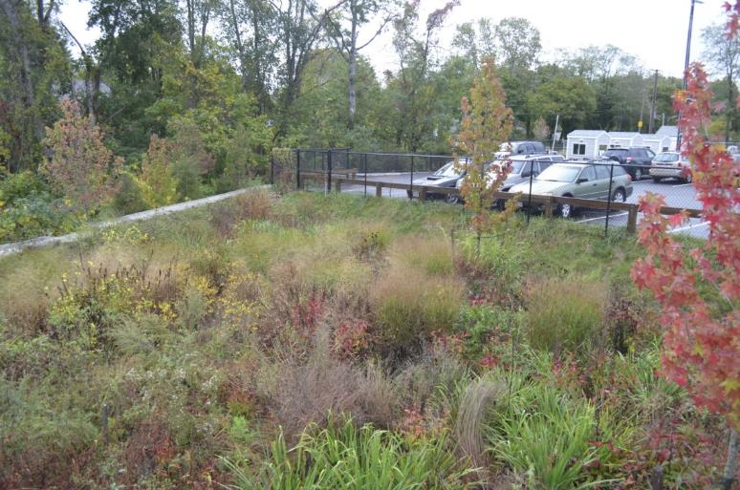
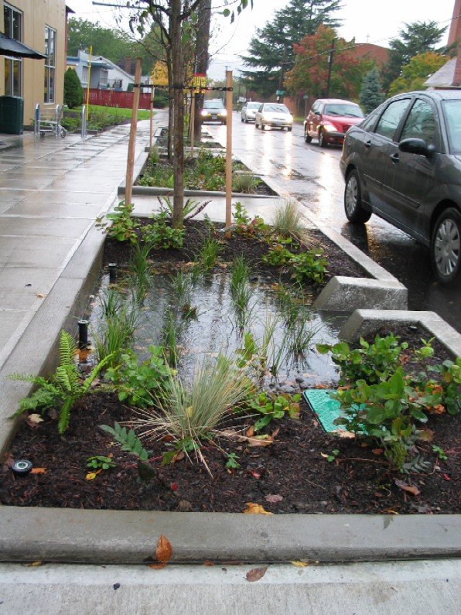

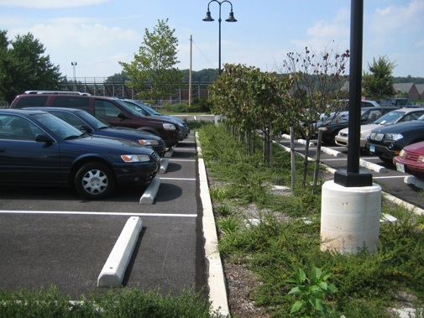
Bioretention at Steamship Auth, Palmer Ave, Falmouth, MA

Slide 14
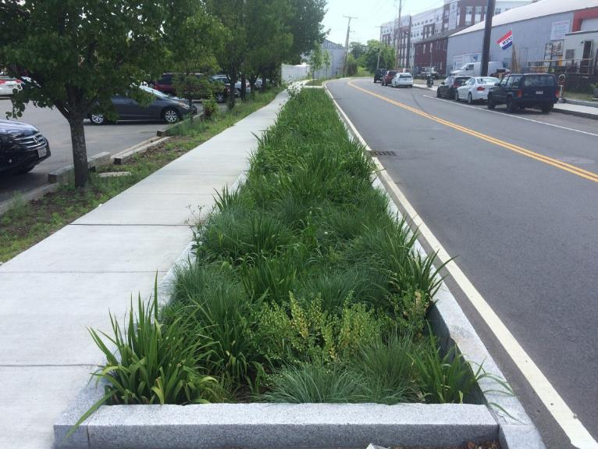
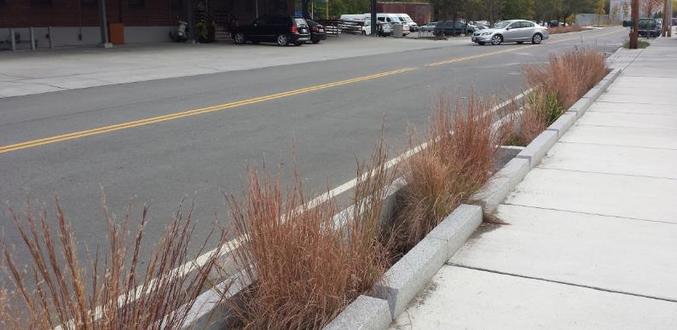
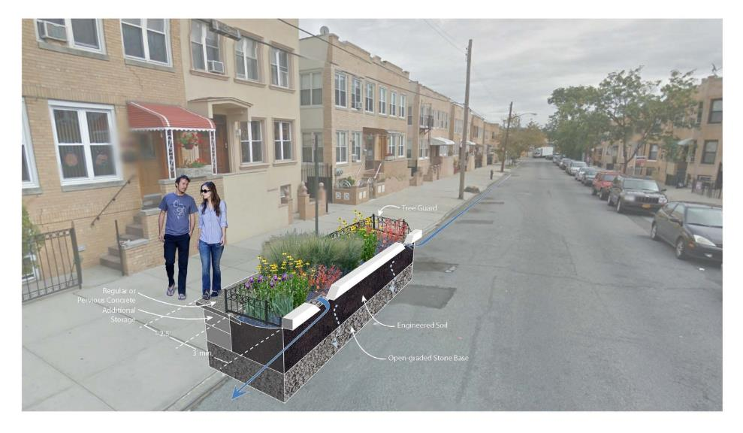
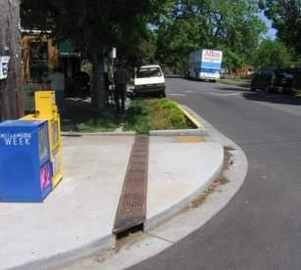
Green Streets

Slide 15
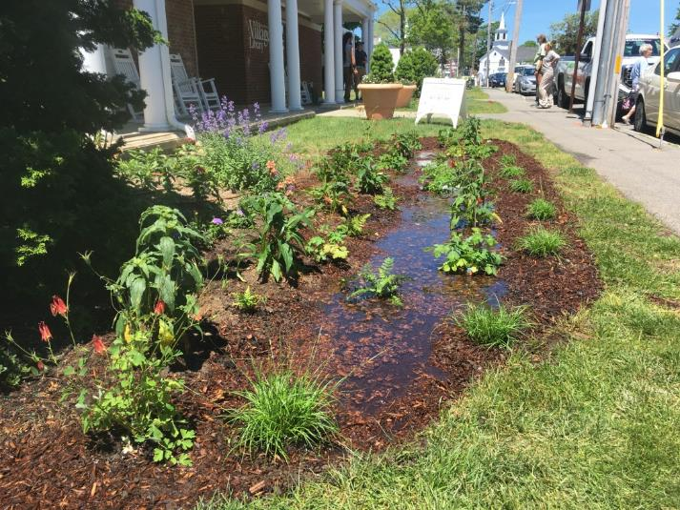
Bioretention Benefits
Benefits:
  Versatile practice
  Runoff reduction, promotes recharge
  Good pollutant removal (> 80% of sediment)
  Aesthetics (combine with site landscaping)
  Modest space consumption
  Natural approach, affecting air quality, temperature, & habitat

Slide 16
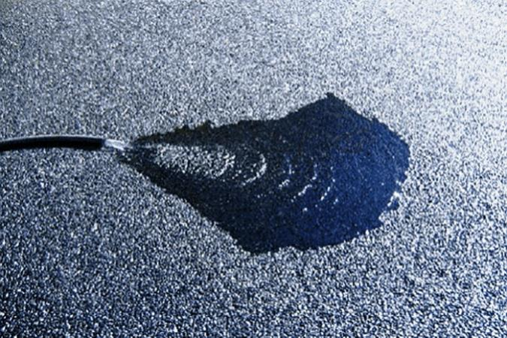
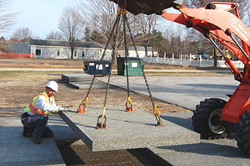
Permeable/Porous/Pervious Pavements
  Permeable surface material that allows rainfall to percolate through the media into underlying soils or drainage collection system.
Practice Variants:
  Permeable pavers
  Porous asphalt
  Pervious concrete
  Proprietary materials (pre-cast pervious slabs, recycled tires/glass)

Slide 17
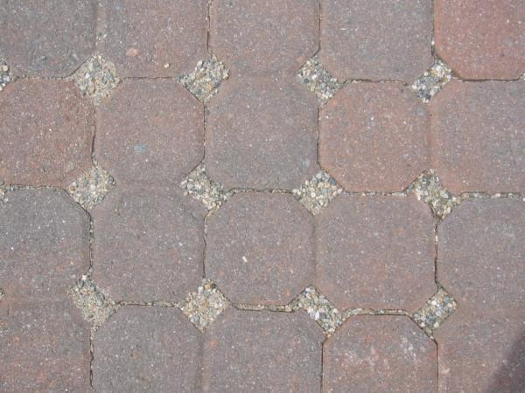
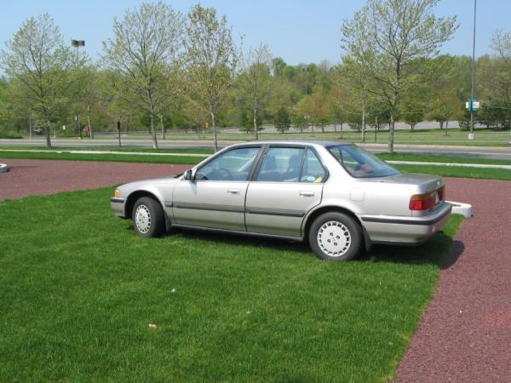
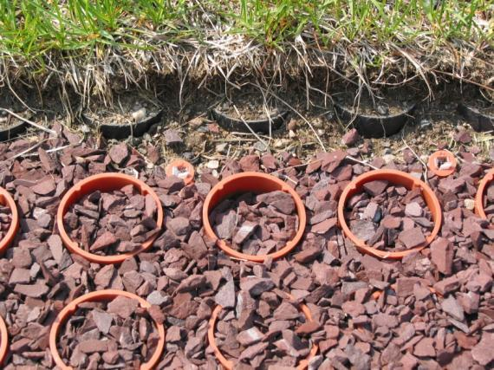
Permeable Paver Options

Slide 18
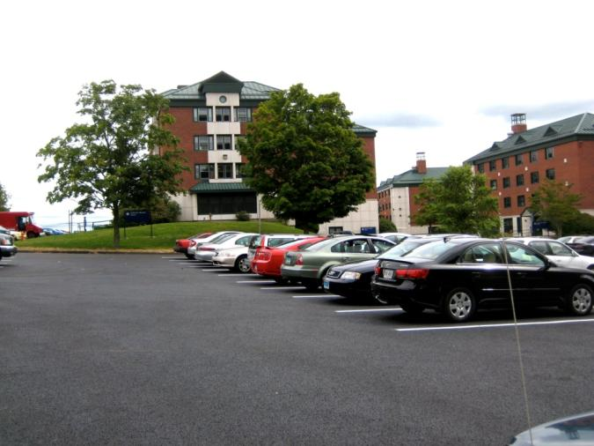
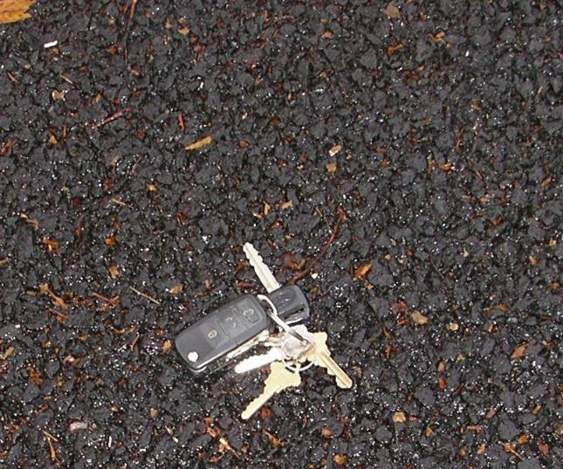
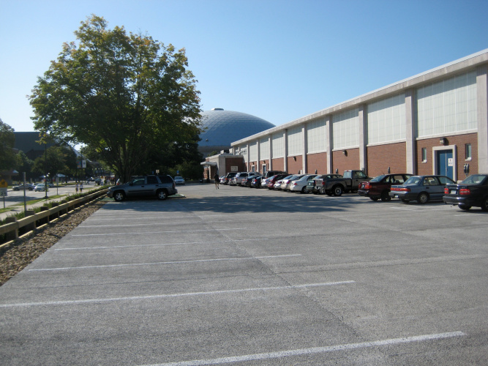
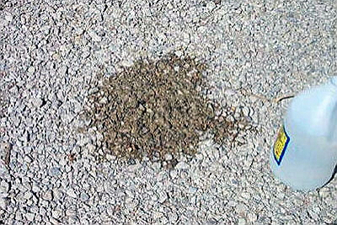

Slide 19
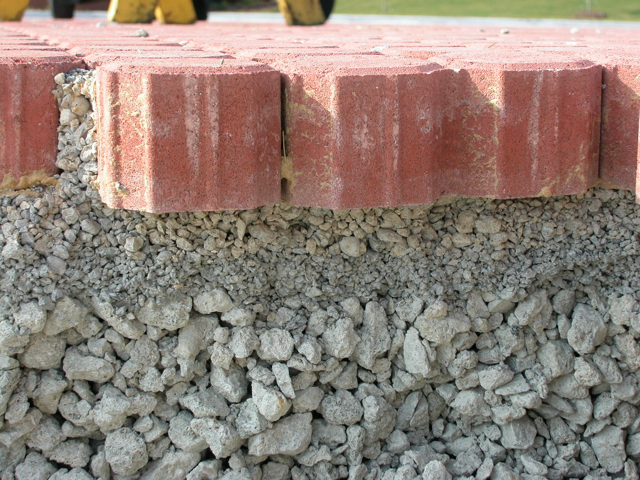

Slide 20
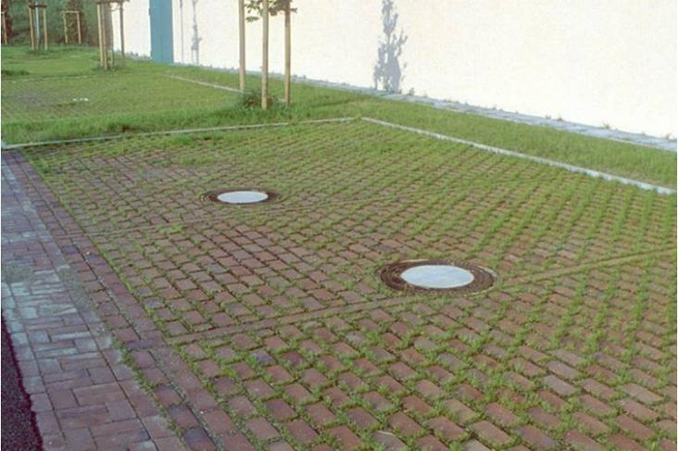
Permeable Pavement Benefits
Benefits:
  Several design options
  Runoff reduction, promotes recharge
  Excellent pollutant removal (> 90% of sediment)
  Aesthetics (mostly applies to pavers)
  No additional space consumption
  Reduces need for sand and salt for winter snow/ice management

Slide 21
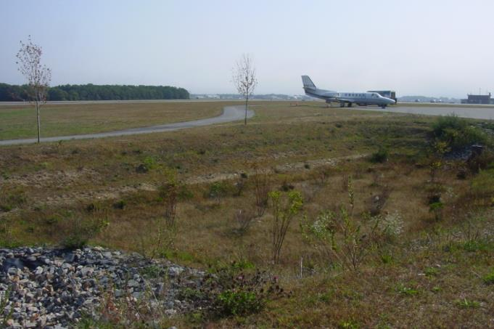
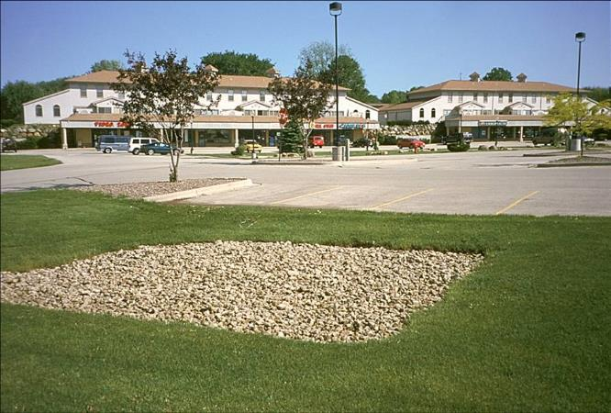
Infiltration
  Stormwater control practices designed to infiltrate runoff into the underlying soils and ultimately recharge the groundwater.
Practice Variants:
  Infiltration basins
  Infiltration trenches
  Underground chambers
  Dry wells

Slide 22
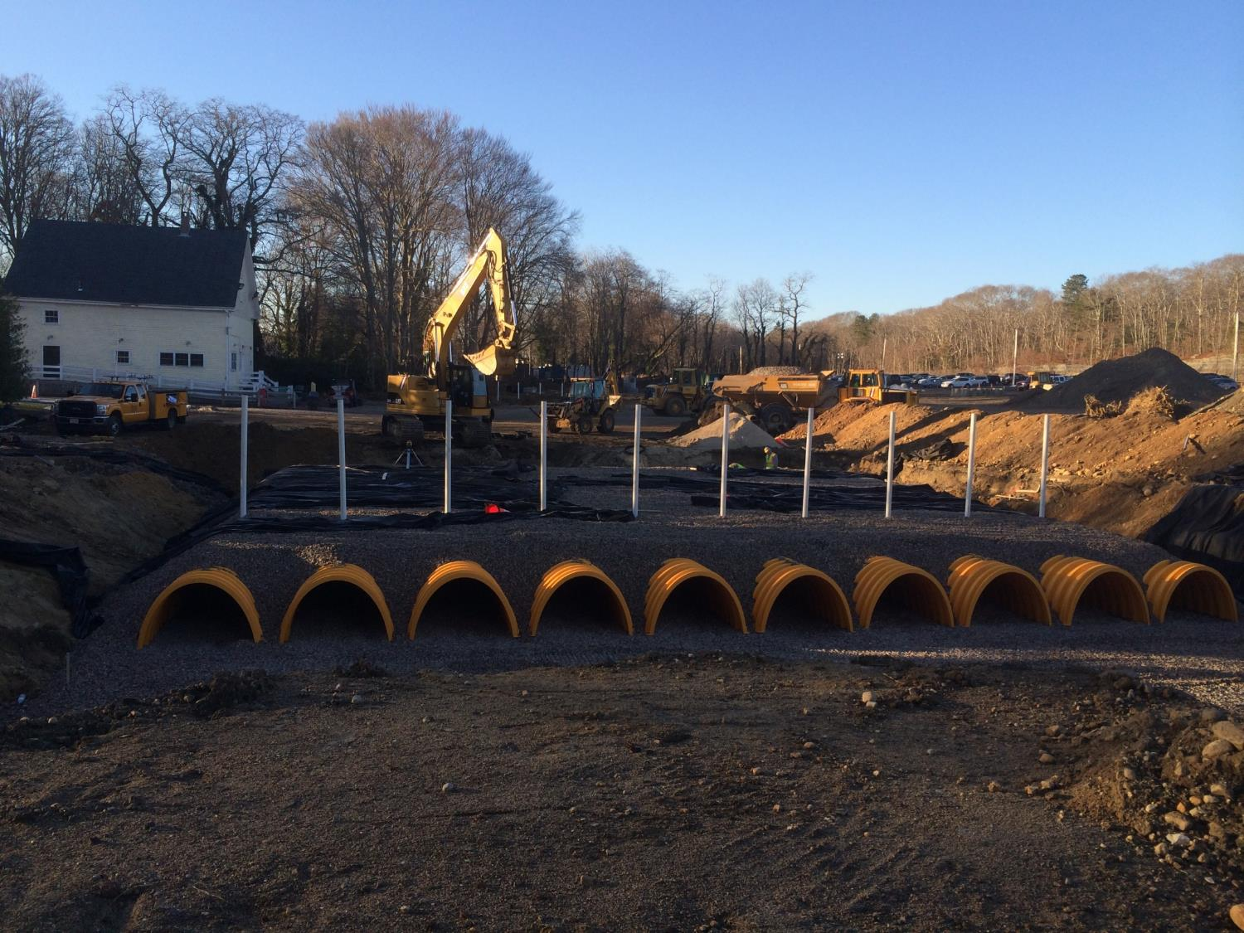

Slide 23
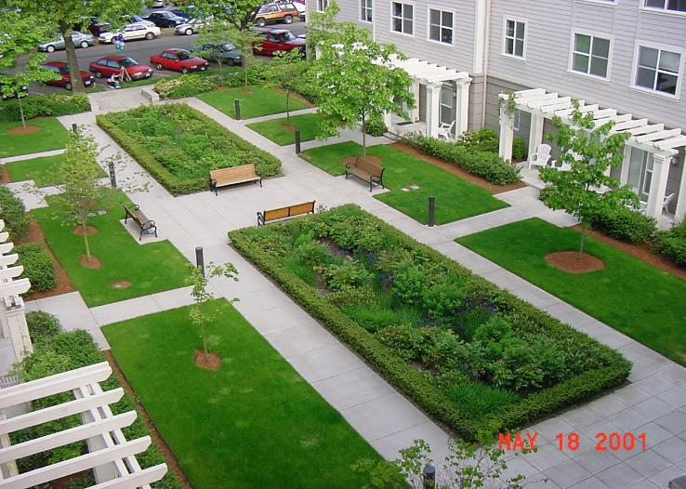
Infiltration Benefits
Benefits:
  Versatile practice
  Runoff reduction, promotes recharge
  Excellent pollutant removal (> 90% of sediment)
  Aesthetics (combine with site landscaping)
  Modest space consumption
  Possible to manage a range of storms from small to large
Buckman Heights courtyard with infiltration garden

Slide 24
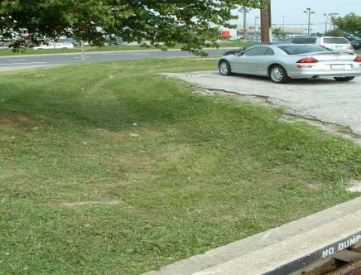
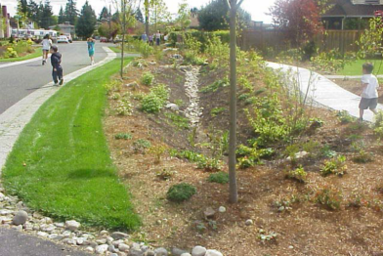
Swales and Open Channels
Removes pollutants through particle settling and filtration.
Infiltration typically occurs as water flows across the surface.
Compost amendments can increase infiltration and water storage, and improve plant health.
Design variants:
Dry swale, wet swale, bioswale, grass channel

Slide 25
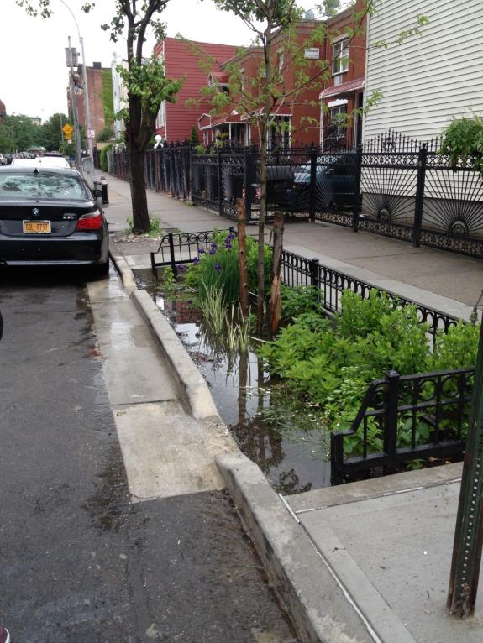
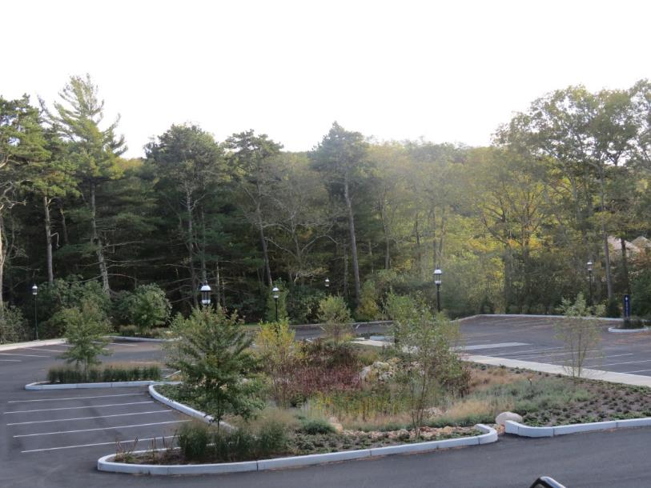
Swales and Open Channels
Bioswale at Heritage Museum & Gardens, Sandwich, MA
Bioswale , New York, NY

Slide 26

Swale/Channel Benefits
Benefits:
  Linear practice (good for roads/highways)
  Runoff reduction, can promotes recharge
  Mixed pollutant removal (possible bacteria source – birds/pets/other wildlife)
  Aesthetics (combine with site landscaping)
  Modest space consumption
  Best in flatter slopes; design variants allow for use in places with high gw/poor soils
Wet Swale at Roger Williams Park, Providence, RI

Slide 27

Regenerative Conveyance System
(aka, Step-pool Bioretention)
Channel that both conveys flows and promotes infiltration and groundwater recharge
Good for steep sloping areas with land area constraints
RCS at Sawmill Pond, N. Kingstown, RI

Slide 28

Constructed Stormwater Wetlands
Design variants:
  Shallow Marsh Wetland (aka, surface wetland)
  Ext. det. Wetland
  Gravel Wetland
  Wet Swale
Wet vegetated treatment systems incorporating natural wetland elements
Combines detention and retention elements that can manage a wide range of storm events (WQ to Q₁₀₀)
Const. Wetland at Scouting Way, Peabody, MA

Slide 29

Constructed Stormwater Wetland Benefits
Benefits:
  Can manage a range of storms (WQ to 100 yr)
  Versatile practice; good in high gw conditions
  Good pollutant removal (especially nitrogen)
  Natural Aesthetics and provides wildlife habitat
  Lower maintenance
  Typically more cost effective than smaller “on-site” GI
Gravel Wetland at Maine Mall, S. Portland, ME

Slide 30


Constructed Stormwater Wetlands
During construction
Five years after construction
WVTS in Chepachet Village, Glocester, RI

Slide 31


Constructed Stormwater Wetlands
Gravel Wetland at Sawmill Pond, N. Kingstown, RI
Wet Swale at Roger Williams Park, Providence, RI

Slide 32



Mashpee Commons – Mashpee, MA
Notes:
Mix use, pedestrian friendly new urbanist development
Stormwater not integrated into the first phase

Slide 33




Mashpee Commons – Opportunities
Notes:
Existing development

Slide 34




Highpoint, Seattle, WA SvR Design
StormTree, Providence, RI

Slide 35
A Few Challenges to GI
Contaminated soils
  Avoid excavation and infiltration in contaminated soils
Areas with high potential pollutant load or discharges to sensitive resources (e.g., Zone II)
  Infiltration prohibited or higher pretreatment standards
Class V well registration
  Infiltration practices that are deeper than they are wide
Conflicts with local development codes
  Subdivision rules may require curbs, two sidewalks, wide roads, stormwater catch basins and pipes, and prescribed street trees, which all can limit flexibility for GI

Slide 36
In Summary….
Green Infrastructure is a useful tool for maintaining, mimicking and restoring natural hydrology and protecting water quality in the developed landscape.
It is flexible, effective, and achieves multiple other benefits.

