Slide 1
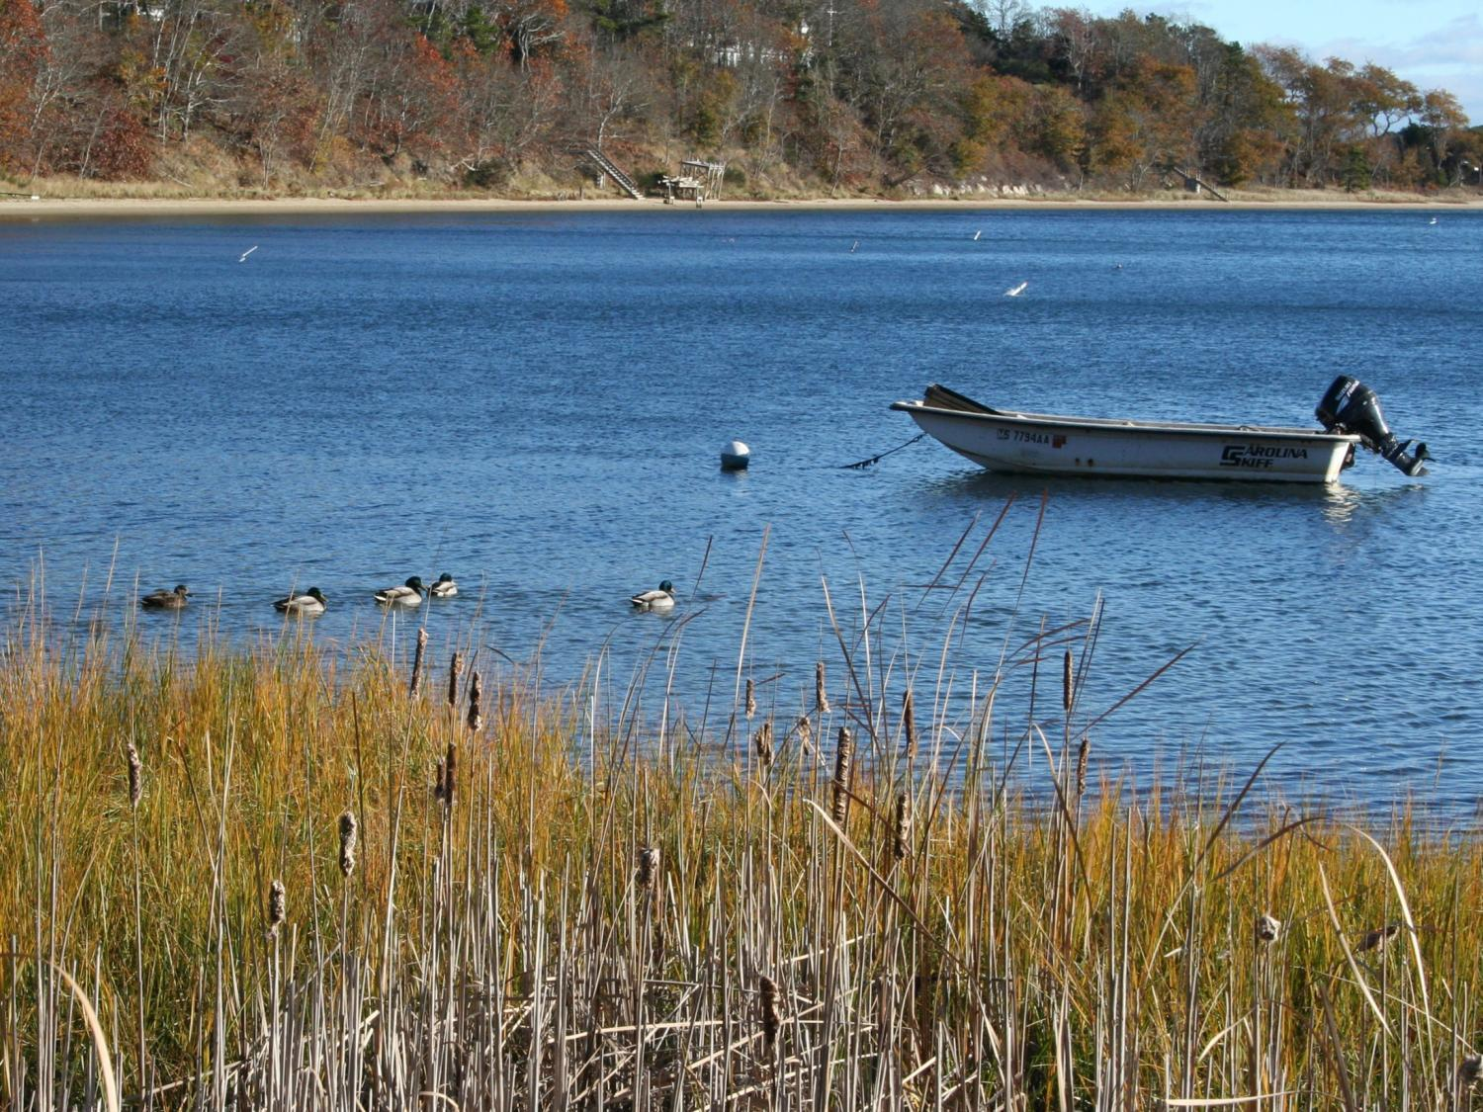
Cleaning Up The Bays Managing Stormwater in the Three Bays
Notes:
Introduce myself:
Restoration Technician working on ecological restoration projects with APCC.
I have a strong personal connection to the Three Bays.
Water quality and environmental health are strong personal concerns of mine in this area.

Slide 2
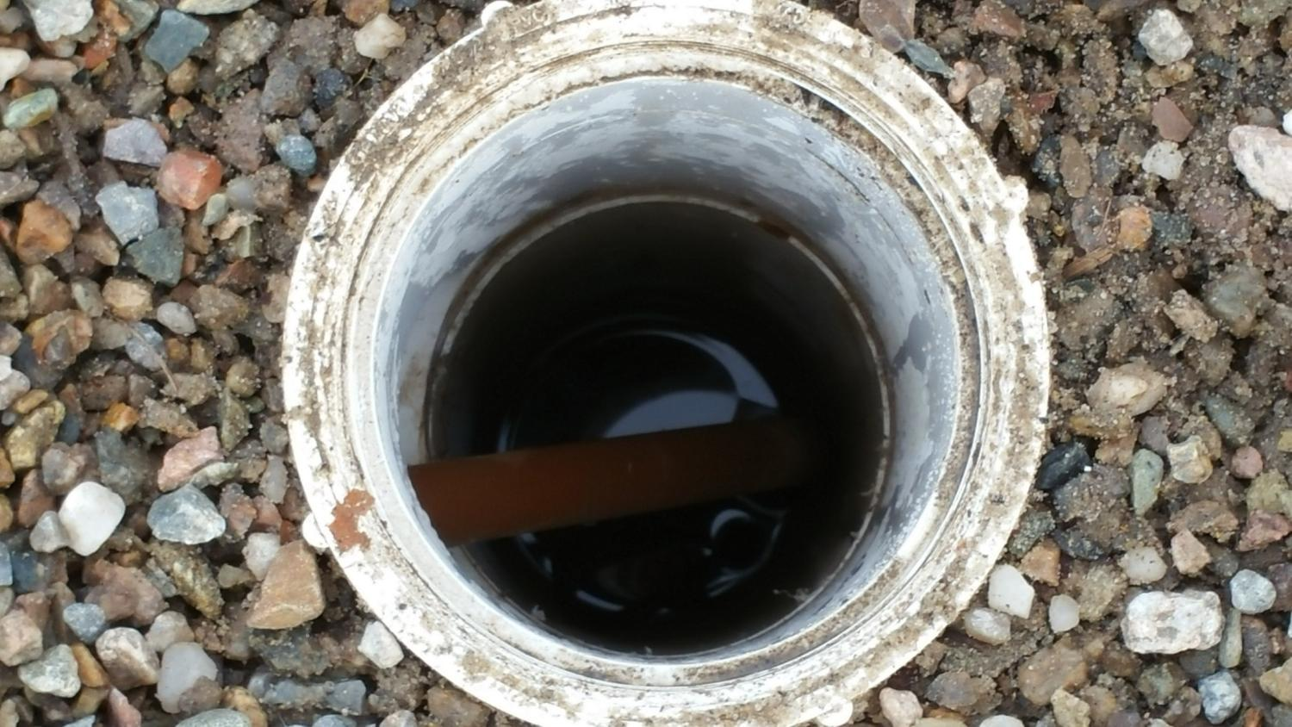
Stormwater 101
What is stormwater?
Why is it a problem?
What can we do about it?
Notes:
This is what I plan to cover…

Slide 3
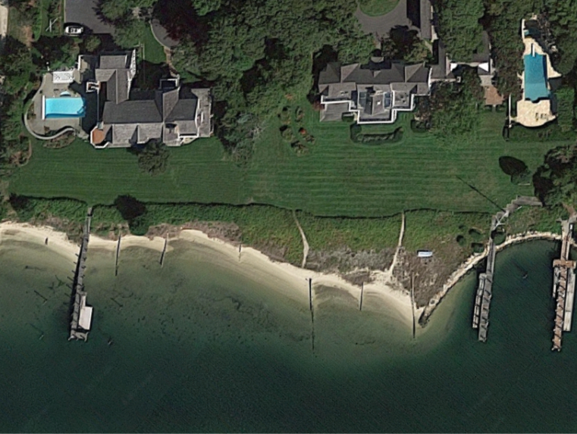
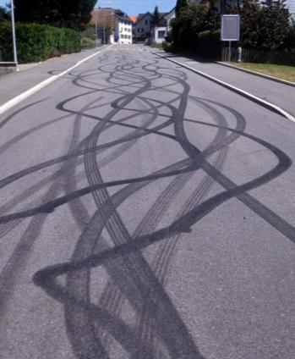
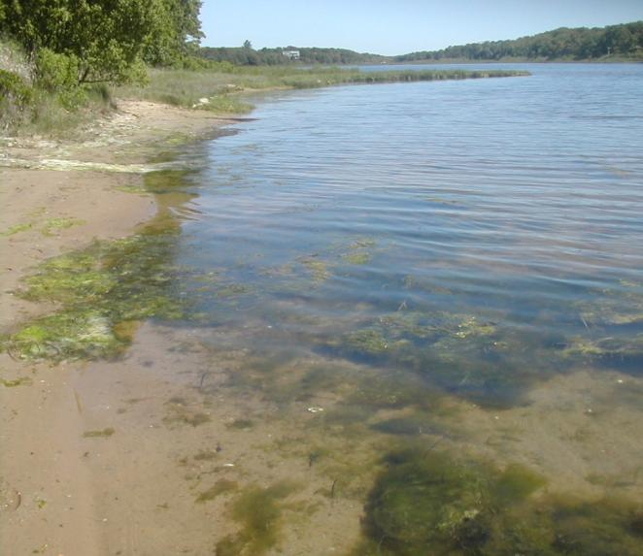
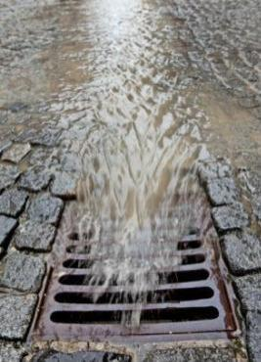
Three Bays Impaired by Excess Nitrogen and Bacteria
Notes:
Listed as impaired by state to meet requirements set forth by the Federal Clean Water Act section 303d.
Widespread degradation of the bays and direct human health and environmental threats.
Hence a strong focus of this project to focus on remediation of N and bacteria sources to bays.

Slide 4
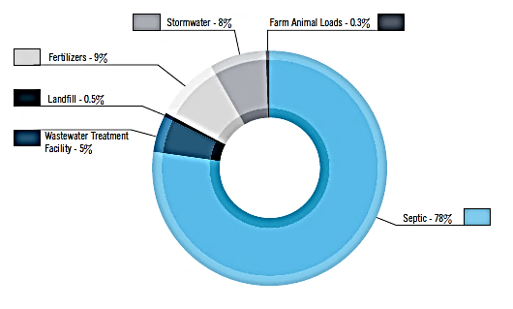
Nitrogen and Stormwater
On average 8% of nitrogen in estuaries across the Cape is from stormwater runoff, and 9% from fertilizer use.
In the Three Bays: more than 23% of nitrogen comes from these two sources.
Nitrogen Sources
Cape Cod
Notes:
Why we chose this estuary for this project – stormwater accounts for a large portion of the nitrogen problem. Low hanging fruit. Town is working on plan to address wastewater and stormwater.
Identified in 208 Plan Update as High Threat Level Embayment
Close to 25% of nitrogen in three bays is from stormwater and fertilizer inputs. While the majority is still coming from septic systems this is a sizeable bite out of the nitrogen issue that can’t be ignored.
The town is currently working to develop a plan to address wastewater management and stormwater. This project complements that effort providing additional funding and capacity to support their ongoing efforts in these areas.
Nitrogen is a priority pollutant to manage in coastal embayments because it contributes to many problems.
And is thus a focus of this project – to reduce nitrogen load in stormwater to Three-Bays through stormwater management techniques.
Nitrogen is naturally existing in ground and surface waters, but excess nitrogen is because of human activities.
Stormwater management doesn’t deal with wastewater inputs of N.
But, fertilizer runoff is a significant source of N in stormwater.
Source: Pg56 208 plan

Slide 5
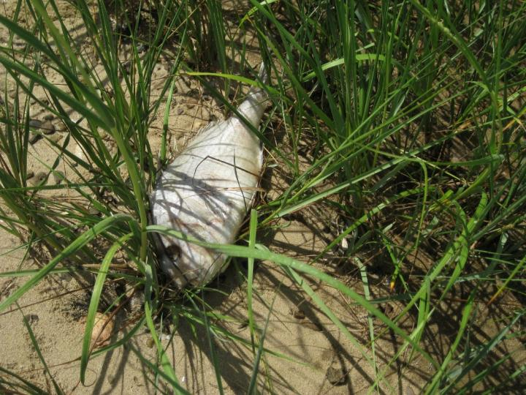
Negative Effects on the Environment and Community
Notes:
Unmanaged stormwater can (and is) leading to…
Effects on Environment
Excessive Algal Growth: Estuaries are typically nitrogen limited systems. Excess nitrogen → rapid plant or algae growth (blooms)
Habitat degradation: including 100% loss of eelgrass throughout the Three Bays estuary. Eelgrass as a keystone species to provide habitat for other species (scallops).
Algal decomposition uses up oxygen leading to low O₂ levels which can harm wildlife and cause fish kills.
Effects on Community:
Health hazards
Beach closures
Shellfishing closures
Algal nuisance
Aesthetics and odor
Lower property values

Slide 6
Project Overview
3 Year Project
Total Cost: $613,326
$472,574 from U.S. EPA Southeast New England Program
Notes:
Three Year project began with initial planning late last year and hiring of Horsley Witten Group as stormwater engineer. Project will be completed in 2020 with final reporting on impact.
Total Cost, Funding from grant EPA. Remainder $140K in kind match from partners (staff time, equipment and expenses)
Project being completed at no cost to public.
Goal: To improve water quality in the Three Bays by reducing or eliminating pollution from stormwater runoff and fertilizer use

Slide 7
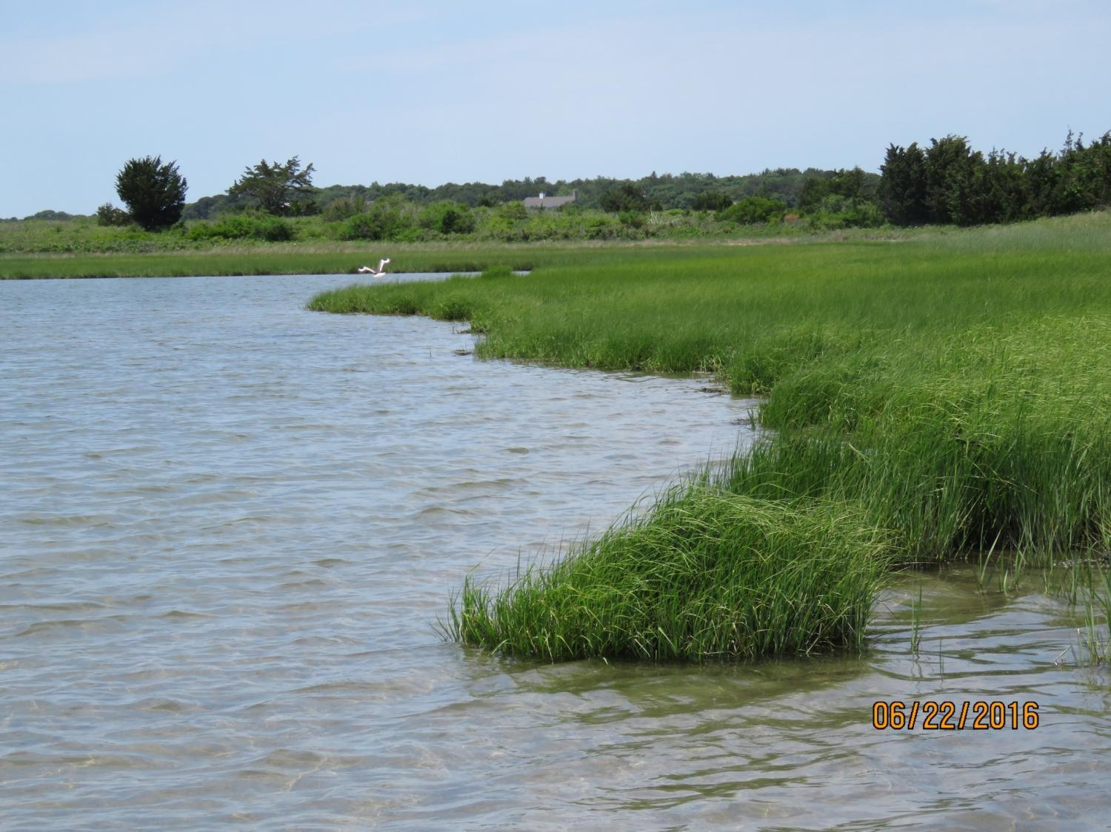
Benefits
Improved habitat for shellfish, fish and wildlife
Restoration of water quality for shellfishing, fishing, boating and swimming
Credit: Barnstable Clean Water Coalition

Slide 8
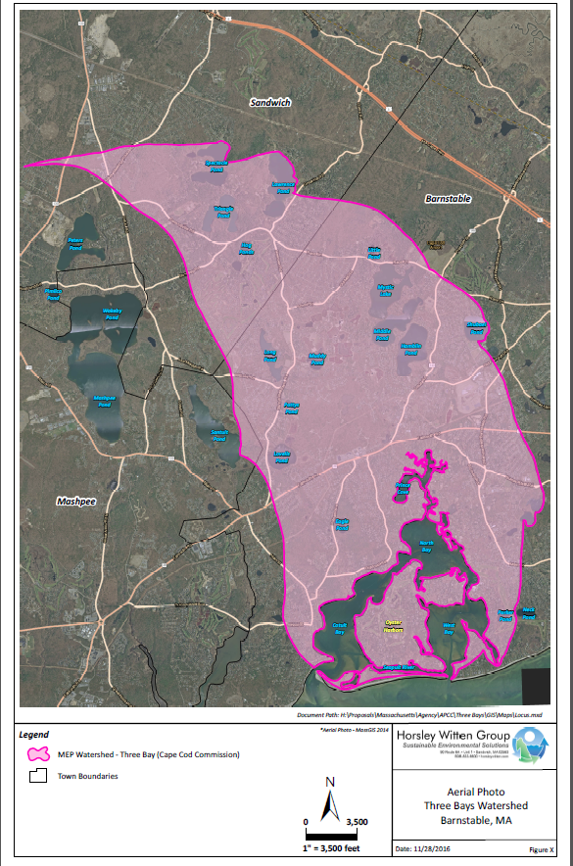
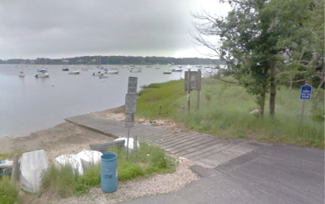
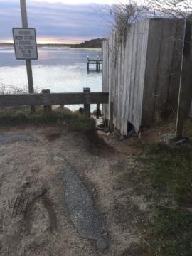
Project Area
Notes:
Partners: Town of Barnstable – primary partner. As the goal of this project is to support their ongoing effort to address stormwater management in this watershed and help clean up the bays. Town will be working closely APCC and the team throughout planning. Identified initial sites of concern, will make the final decision as to location for new sto

Slide 9
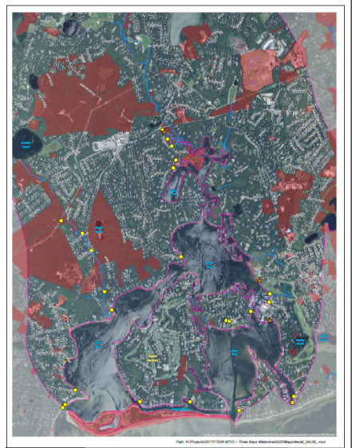
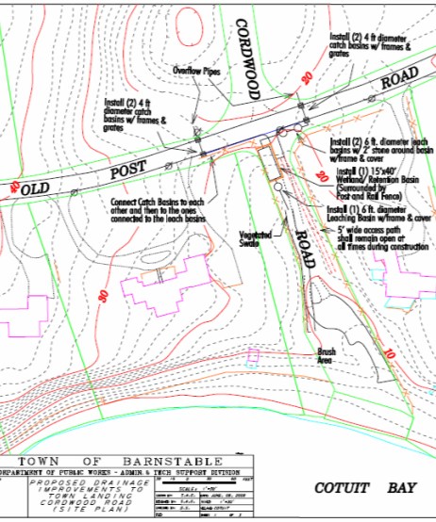
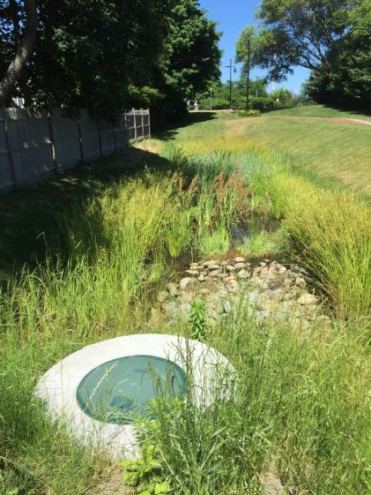
Approach
Assessment and Prioritization
Design and Permitting
Installation
September - December 2018
March – August 2017
2017 – 2018
Notes:
Assessment and prioritization: Building on existing inventories of stormwater sites, we are in the process of completing a watershed assessment to identify problem sites where installation of a green infrastructure BMPs on town owned or public property can help address the problem. For each of these sites HWG will complete initial mapping and calculations to come up with estimations of benefits and costs and develop concept design plans as to what can be done to address and treat stormwater at that site. This list of sites will then be prioritized and reviewed both by the team and the public at our next meeting in August or September.
Design and Permitting: Additional site assessment and complete full design plans and file permit applications for each site. With this project we aim to target management of runoff from a minimum of 4-6 acres of impervious surface, with two or more treatment systems.
Installation: Late 2018. Installation of new stormwater BMPs.
Ongoing throughout the project will be opportunities for public to provide input and get involved.

Slide 10
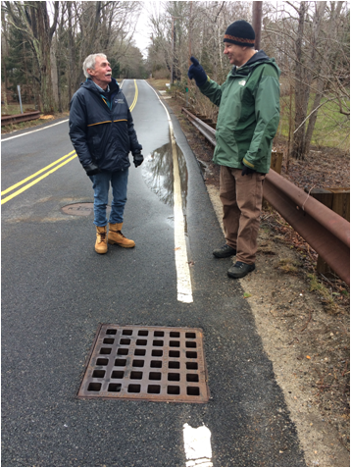
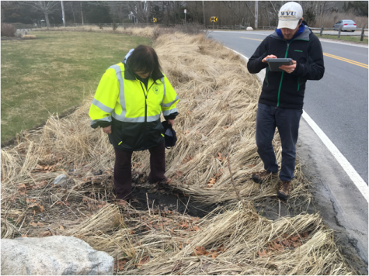
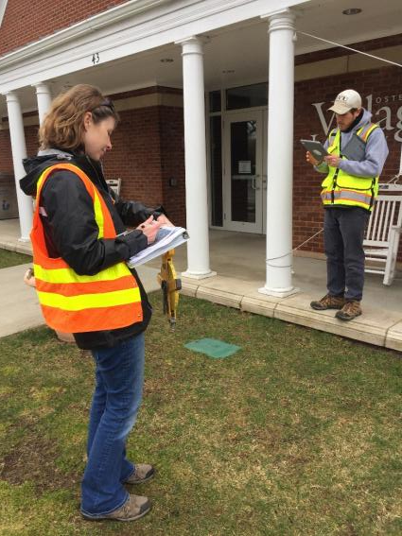
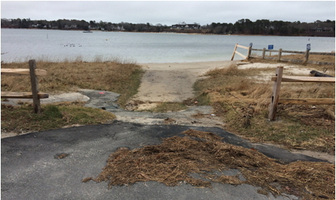
Field Assessment - Methods
Collect data on iPads loaded with existing info
Visit pre-identified areas
Talk to the experts/locals

Slide 11
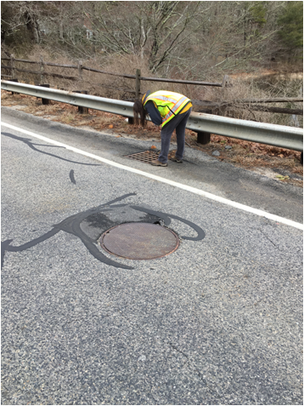
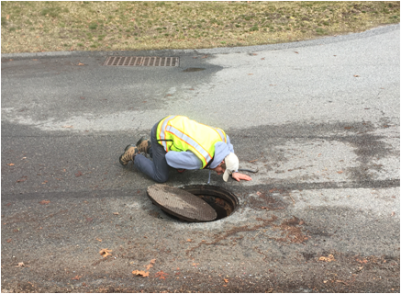
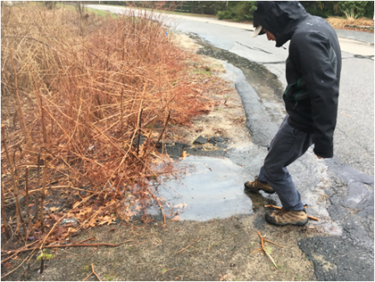
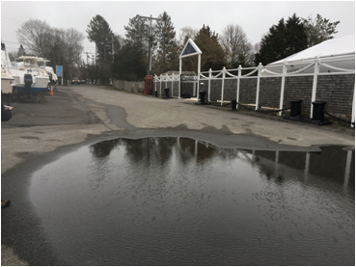
Field Assessment - Methods
Be Stormwater Detectives!
Follow the flow
Look for signs of existing problems (flooding, erosion, sediment build-up, etc.)
Find available space for BMPs
Identify constraints
Notes:
Field assessment: collect geo-referenced information (e.g., drainage area to practice; available area; proposed BMP area, depth, and volume; and site constraints) and photos at each site.

Slide 12
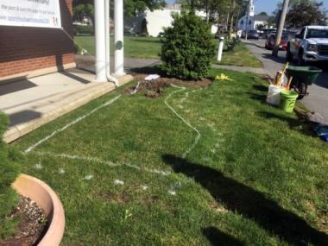
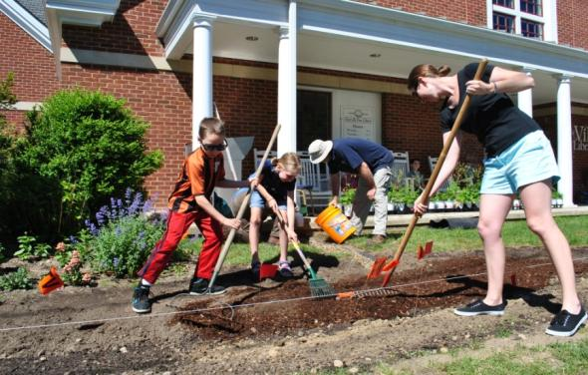
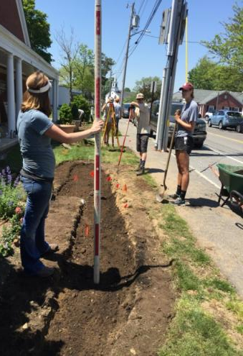
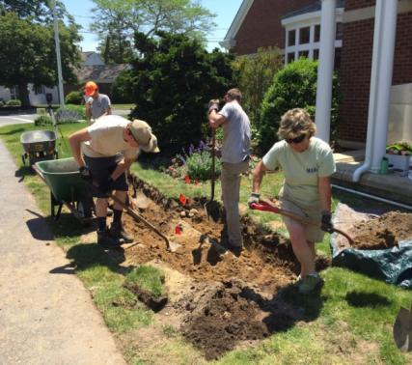
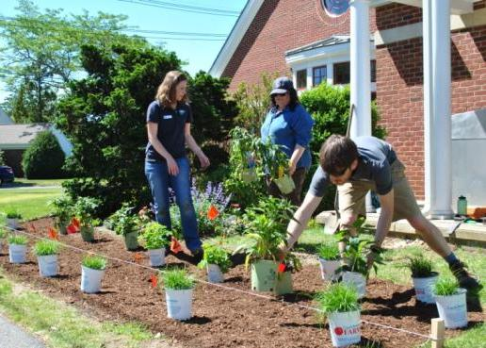
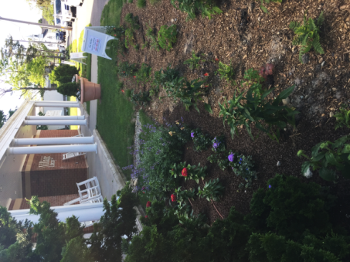
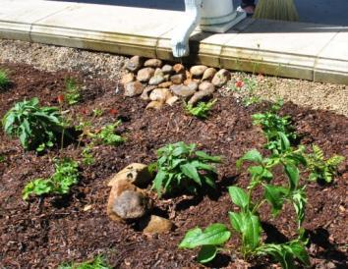
Osterville Library Rain Garden
Photo Credits: APCC, Tara Racine and Horsley Witten Group

Slide 13
After the Fieldwork…
Collect additional information
Perform sizing calculations
Develop concept designs
Calculate pollutant removal
Estimate costs
42 Ranked Sites and many more unranked project suggestions!
Notes:
Field assessment: collect geo-referenced information (e.g., drainage area to practice; available area; proposed BMP area, depth, and volume; and site constraints) and photos at each site.

Slide 14
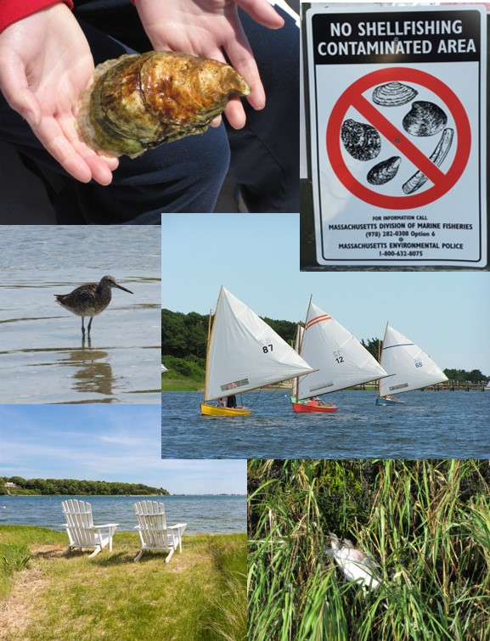
Prioritization of Sites
Pollution Removals
Cost
Ease of Implementation
Additional Benefits:
Public Education
Direct benefits to the key resources? (shellfish beds, beaches, fish, etc.)
Credit: Three Bays Preservation, Inc.
Notes:
To determine at minimum: area of impervious surface addressed, estimated reduction in pollutant loading (nitrogen, bacteria, etc.) from a retrofit installation, ability to address multiple pollutants, cost of design, shellfish bed improvement, and calculation of other resource area benefits.

Slide 15
Priority Sites
Cotuit:
Cotuit Center: Ropes Beach (CO 7/8/9)
Little River: LR1-2
Cordwood Landing: CW-2
Marstons Mills:
Prince Cove: PC-1
Warren’s Cove: WC1-1a/b
Osterville:
Osterville Center: OS2-6
Eel River: ER-1

Slide 16
Cotuit Sites:

Slide 17
CO-7B: Ropes Beach

Slide 18
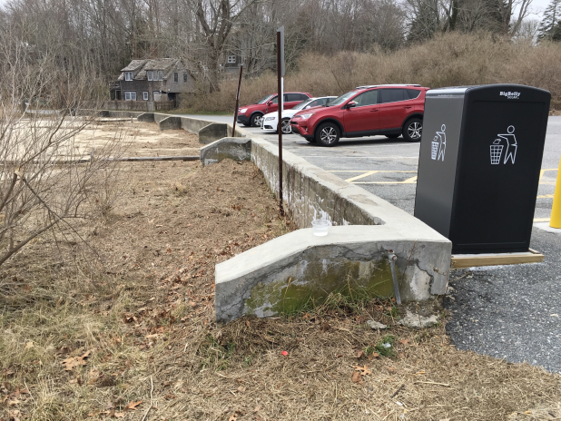

Slide 19
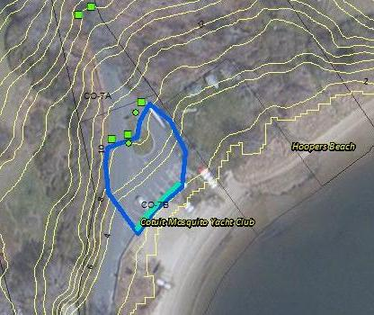
Concept:
Pavement Reduction
Gravel Wetland
Keep Parking but Move Back
Public Education: Incorporate Site into Cotuit Stormwater Walking Tour

Slide 20
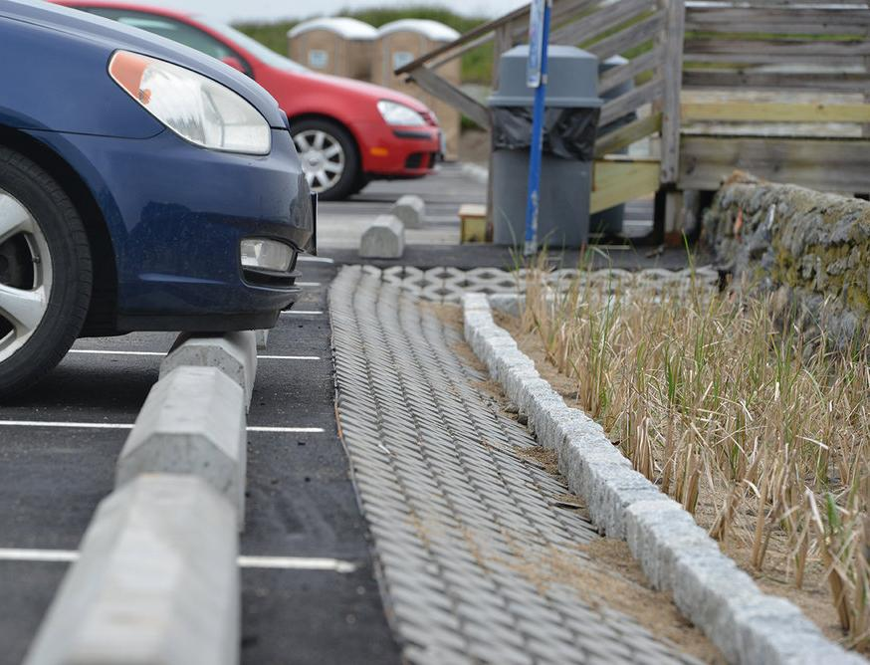
Parking Lot Swale

Slide 21
CO-8: Ropes Beach

Slide 22
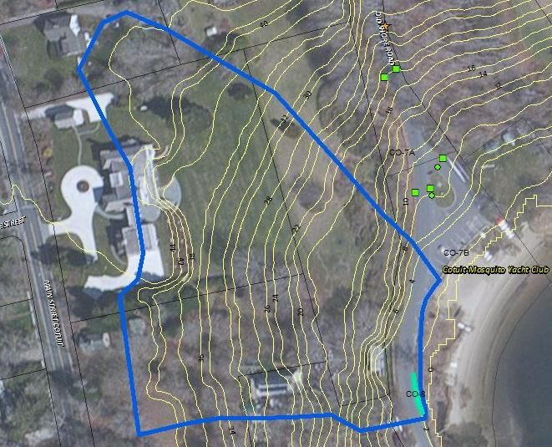
Concept:
Wet Swale
Salt Marsh Restoration
Public Education: Incorporate Site into Cotuit Stormwater Walking Tour

Slide 23
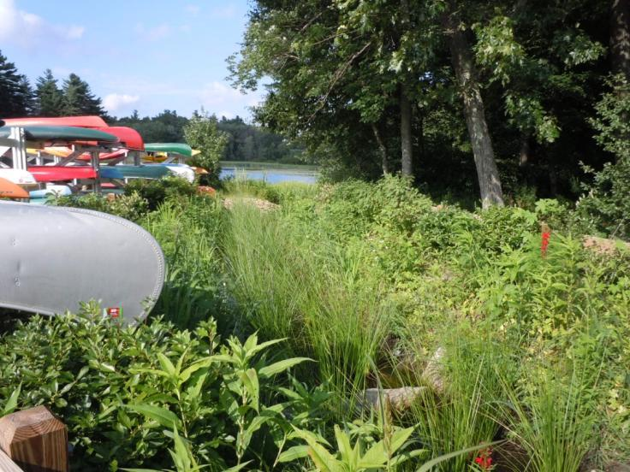
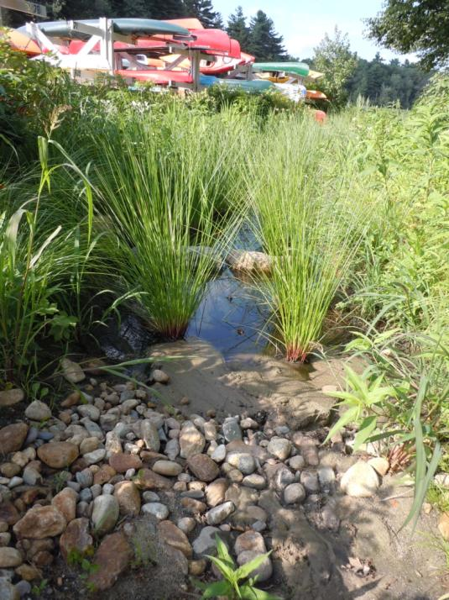
Wet Swale

Slide 24
CO-9: Town Landing on Old Shore

Slide 25
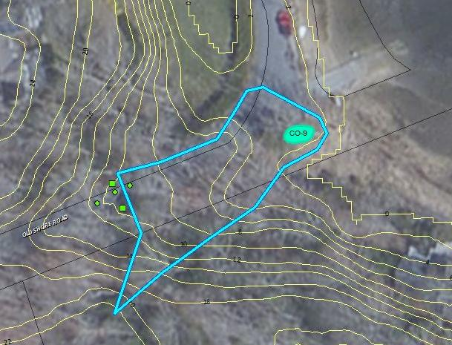
Concept:
Wet Swale
Public Education Cotuit Stormwater Walking Tour
Potential for capturing more runoff/expanding stormwater treatment
Pavement reduction or alternative surfaces?

Slide 27
LR1-2: Little River Landing
Notes:
At the end of Little River next to Cotuit Oyster/parking. Water access

Slide 28
Remove Old Pavement and Restore Marsh
Stormwater Treatment

Slide 29
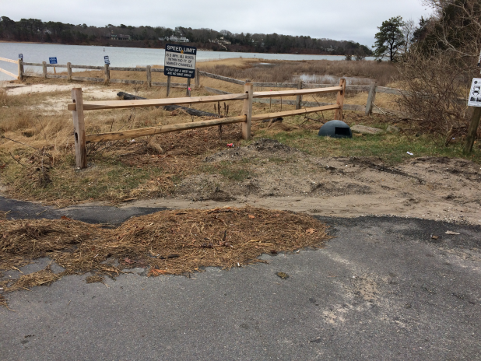
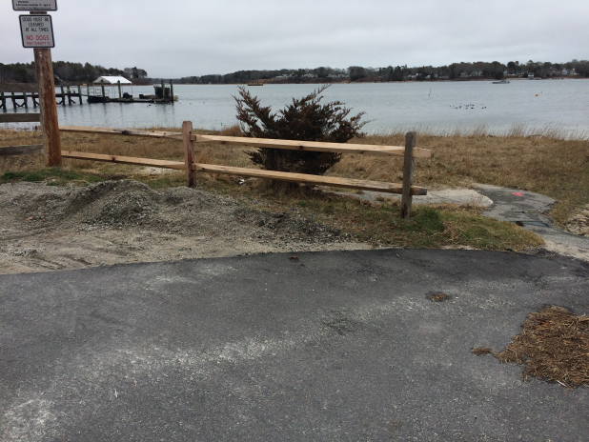
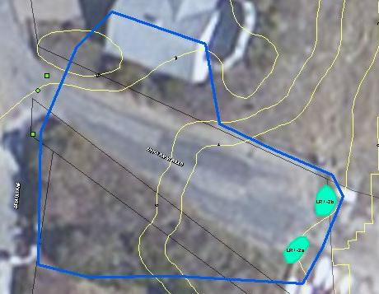
Concept:
Pavement Reduction
Salt Marsh Restoration
Wet Swales
Stabilized/Improved Water Access
Public Education

Slide 30
CW-2: Cordwood Landing

Slide 32
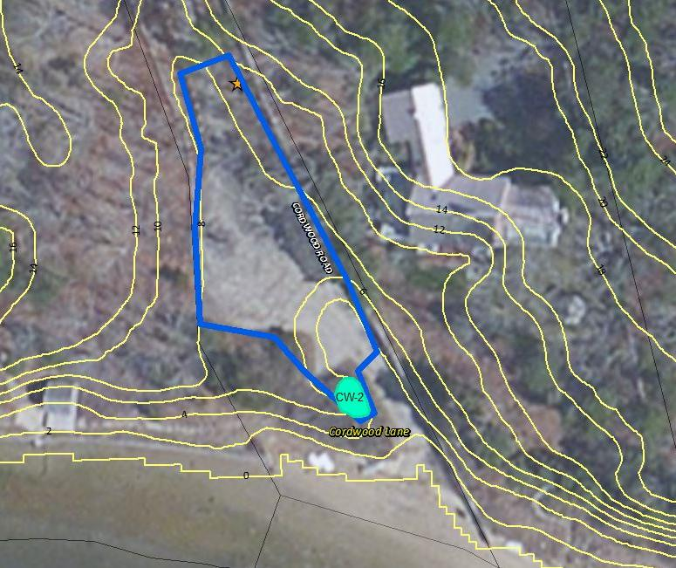
Concept:
Invasive Species Removal/ Buffer Restoration
Bioretention
Stabilized/ Improved Water Access
Improve Parking Lot
Public Education

Slide 33
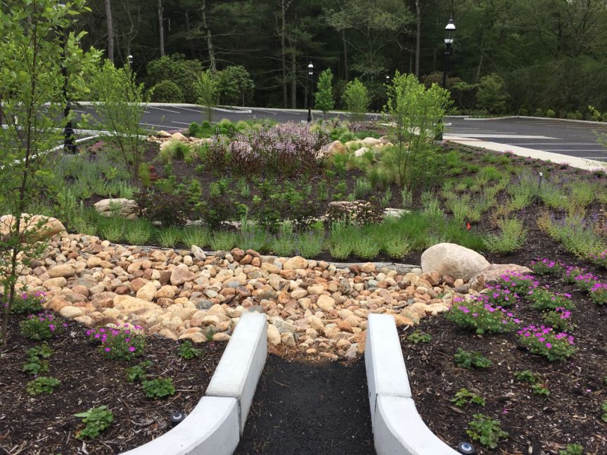
Bioretention Area

Slide 34
Marstons Mills:

Slide 35
PC-1: Prince Cove Marina

Slide 36
Concept:
Pavement Reduction
Bioretention
Coordination with Barnstable Land Trust
Buffer Restoration
Public Education

Slide 37
WC1-1A/B: County Road

Slide 38
Concept:
Dry Swales
Example of how to manage runoff from similar roads throughout Town

Slide 39
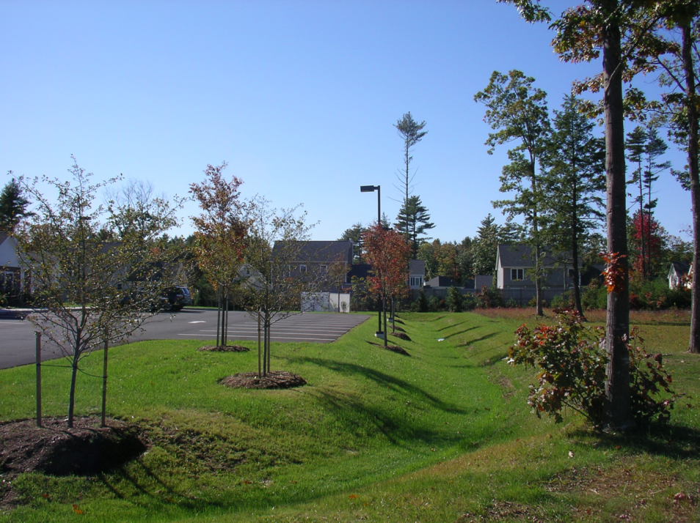
Dry Swale

Slide 40
Osterville:

Slide 41
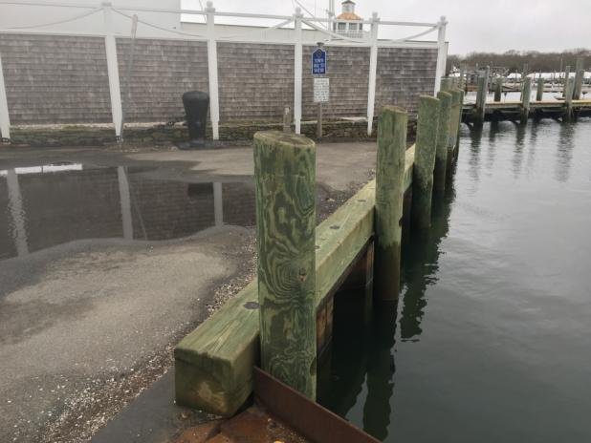
OS2-6: End of W. Bay Rd

Slide 42
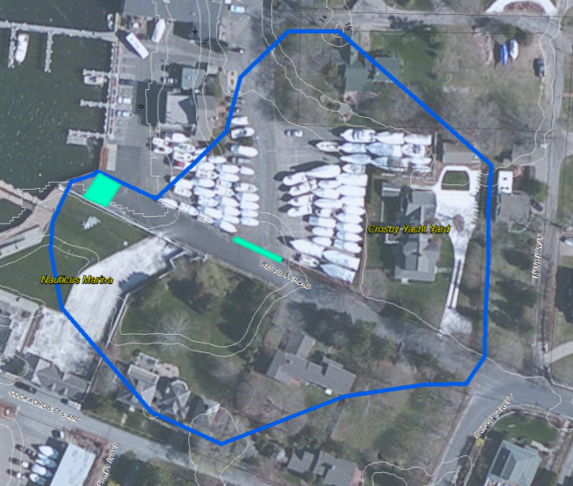
Concept:
Pavement Reduction
Underground Sand Filters
Public Education
Public/ Private Partnership Opportunity

Slide 43
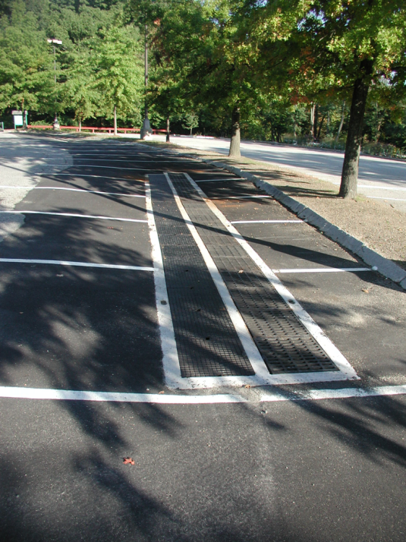
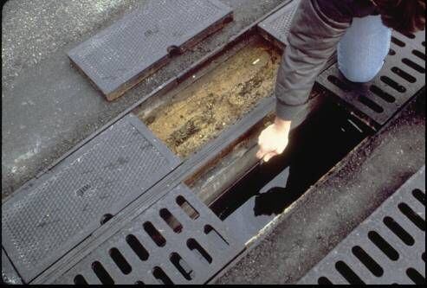
Sand Filter

Slide 44
ER-1: End of Seaview Ave
Notes:
Site:
Direct Discharge into West Bay
Road expands from 20’ - 34’
Catch basin not functioning
Sedimentation and erosion
Frequently used area for water view/fishing

Slide 45
Concept:
Pavement Reduction
Bioretention
Stabilized/Improved Access
Public Education
Notes:
Ensure space for turning around remains
Bike rack? Bench? Additional parking signage?

Slide 46
Breakout Groups

Slide 47
Next Steps and Timeline
Assessment and Prioritization
Design and Permitting
Installation
September - December 2018
March – August 2017
Fall 2017 – Spring 2018
Notes:
Assessment and prioritization: Building on existing inventories of stormwater sites, we are in the process of completing a watershed assessment to identify problem sites where installation of a green infrastructure BMPs on town owned or public property can help address the problem. For each of these sites HWG will complete initial mapping and calculations to come up with estimations of benefits and costs and develop concept design plans as to what can be done to address and treat stormwater at that site. This list of sites will then be prioritized and reviewed both by the team and the public at our next meeting in August or September.
Design and Permitting: Additional site assessment and complete full design plans and file permit applications for each site. With this project we aim to target management of runoff from a minimum of 4-6 acres of impervious surface, with two or more treatment systems.
Installation: Late 2018. Installation of new stormwater BMPs.
Ongoing throughout the project will be opportunities for public to provide input and get involved.

Slide 48
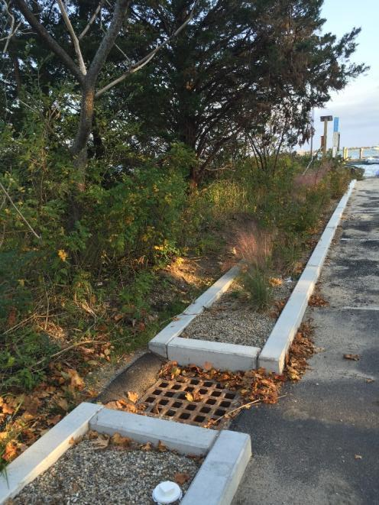
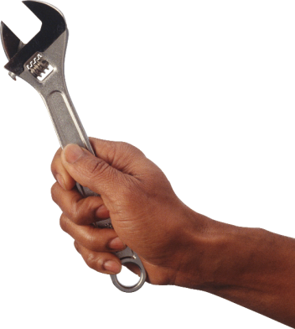
Upcoming Events
Go to www.apcc.org for more info and to register
Guided Walking Tour
Maintenance Workshop
Cotuit Village Stormwater
Date/Time TBD
Early November
Types of Stormwater Treatment Practices
Basic maintenance
Above ground clean out
Planting
Care of Plants
Reporting to town on issues or concerns
Notes:
Cotuit Village Walking Tour: Have self-guided tour brochures. Encourage you to take one and go out on your own to take a look at some existing stormwater treatment systems in the area. But also offering guided tour of these sites with professionals who installed them. Opportunity to get more detailed explanation of how they were installed and how they work. Go to www. Apcc.org click on events or Three Bays project from homepage to get more info and sign up.
Rain garden workshop: Goal is to address the problem at the source and reduce volume of runoff by capturing rain water at the source. Simple rain gardens are a great way to do this. Building a small depression planted with native plants. Can help soak up the rain and remove pollution. On June 15th will be hosting a rain garden workshop to teach you more about how rain gardens work and have you get your hands dirty with installation of this demonstration rain garden in front of the library to capture rain water from roof of the porch. For this event space will be limited but we encourage people to stop by that week to see the work in progress.

Slide 49
Questions?
Contact
Project: April Wobst, awobst@apcc.org
Upcoming Events: Kristin Andres, kandres@apcc.org
Notes:
Sources:
https://www.epa.gov/green-infrastructure/what-green-infrastructure
https://rainbank.info/how-to-reduce-stormwater-pollutants/
https://www.montgomerycountymd.gov/water/stormwater/about.html
http://www.phila.gov/water/PublishingImages/naturalvsurbanrunoff.jpg
http://www.capecodcommission.org/index.php?id=491&maincatid=76

Slide 50
What You Can Do
Reduce use of fertilizers and pesticides
Reduce area of lawn
Install native plants
Mulch leaves and grass clippings
Pick up pet waste
Only rain down the drain
Rain barrels or gardens
Septic maintenance
Notes:
There is a lot that individuals can do to reduce stormwater volume and reduce pollutants at the source with on-site treatment.
Avoid contributing to town runoff volume – treat on your property
Use native plants to help treat pollutants, take up nitrogen. Create vegetated buffer. Planted areas compared to lawn increase infiltration.
Don’t dump in catch basins!

